Slide 1
Implementing a skidding policy in London
Chris Kennedy, Martin Sachs, Mark Stephenson
W.D.M. Limited
North View, Staple Hill, Bristol BS16 4NX
Telephone: 0117 956 7223 Web: www.wdm.co.uk

Slide 2
The road network
London main road network
2156 km overall network length
585km Transport for London Road network
1,571km of Borough Principal Roads

Slide 3
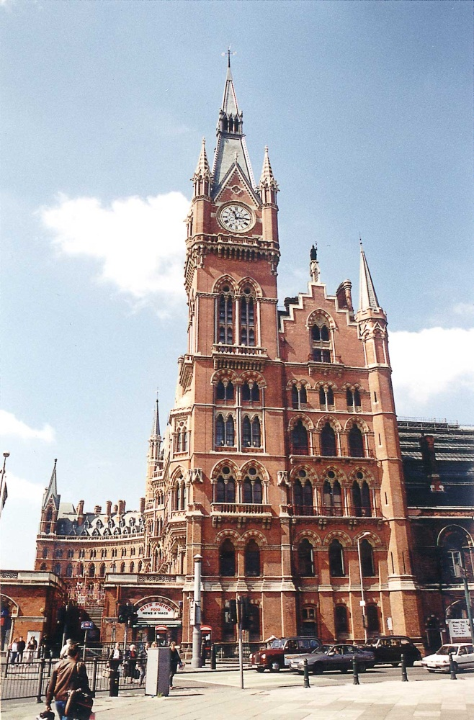
Governance arrangements
Transport for London (TfL)
32 Boroughs and the City of London
All are highway authorities with own policies, budgets and different priorities
London Mayor’s Transport Strategy (MTS) sets out the overall transport objectives
TfL allocate ‘London wide’
money to Boroughs
Notes:
Mayors transport study published in 2010

Slide 4
Project aim – to support the MTS
‘safer roads through better
design and road safety engineering’
To take a risk based approach to setting investigatory levels
To develop a common approach to the management of skidding resistance throughout the city
Provide tools and guidance for the Borough Engineers to apply

Slide 5
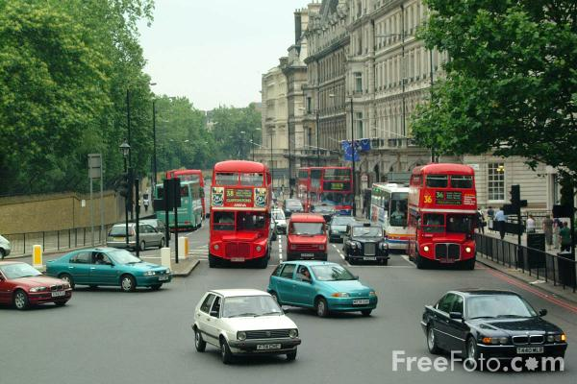
Project outcomes
Year | Outcomes
2008 | Establish site categories
2008 | Detailed crash study
2009 | Training Guidance and policy documents
2010 | Deficiency listing
2011 | Deficiency listing Pan London weighting Reviews Further training
Notes:
Suggestion is that the current work is most relevant for presentation

Slide 6
Measurement of skid resistance
Surveys carried out annually using SCRIM® over the whole network

Slide 7
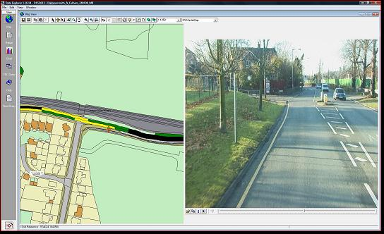
Approach to Junctions
Establishing site categories
The length of an Approaches to Junctions are nominally 50m leading up to the junction and the length across the junction. This may include the start of a new section.

Slide 8
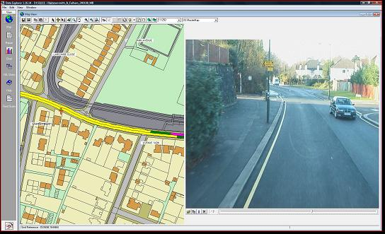
Multiple Junction
Establishing site categories
Where there were occurrences of multiple junctions or other busy accesses the Approach to Junction categories were joined together.

Slide 9
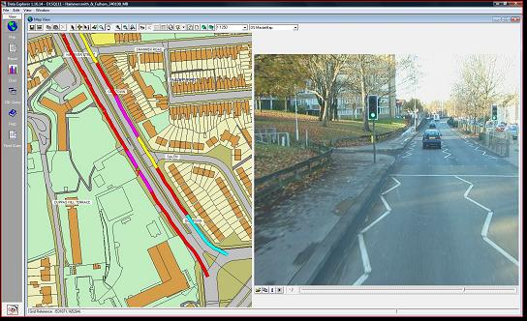
Approach to crossings
Establishing site categories
The 50m approach and extent of pedestrian crossings were categorised.

Slide 10
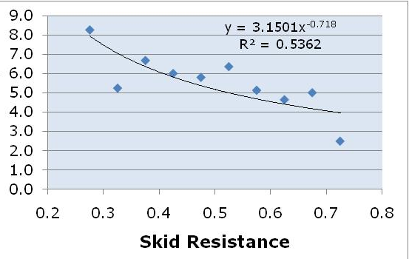
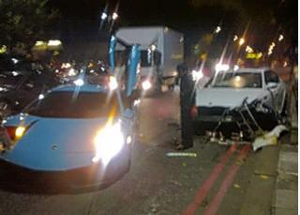
Crash rate vs skid resistance study
Crash rate

Slide 11
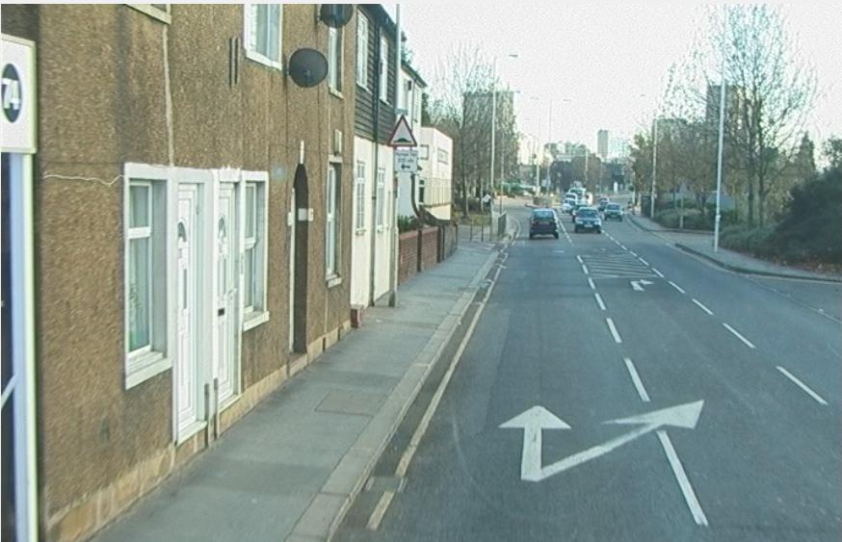
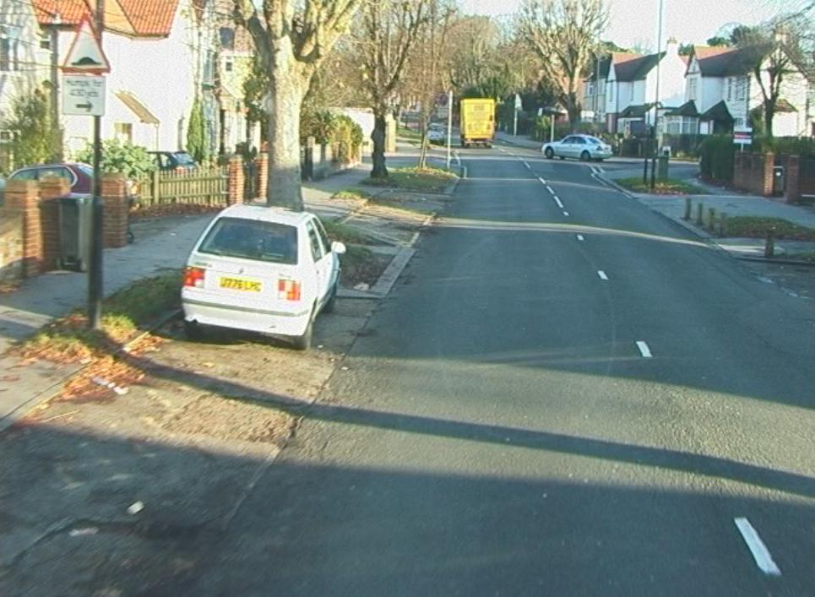
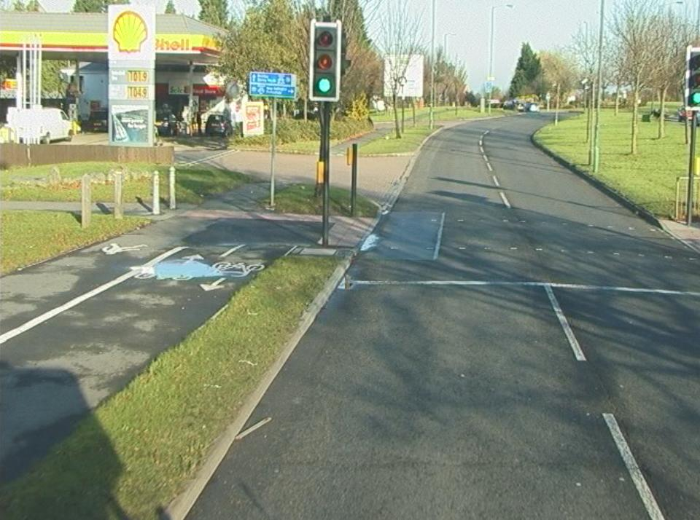
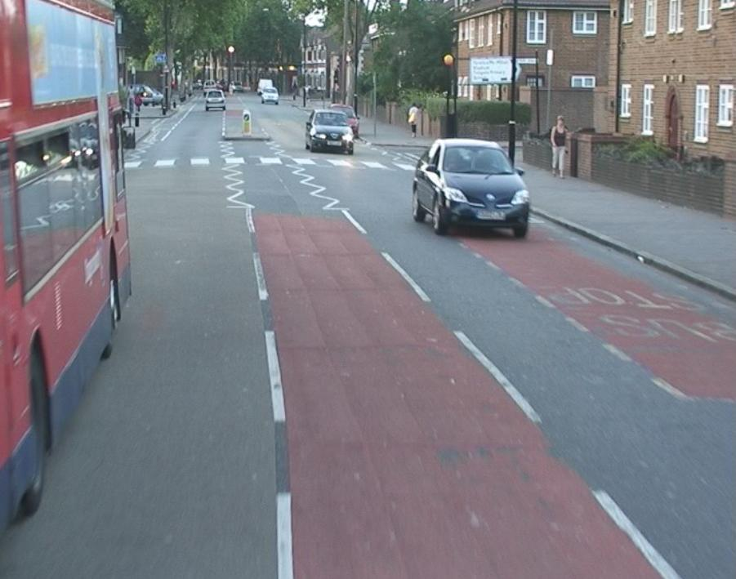
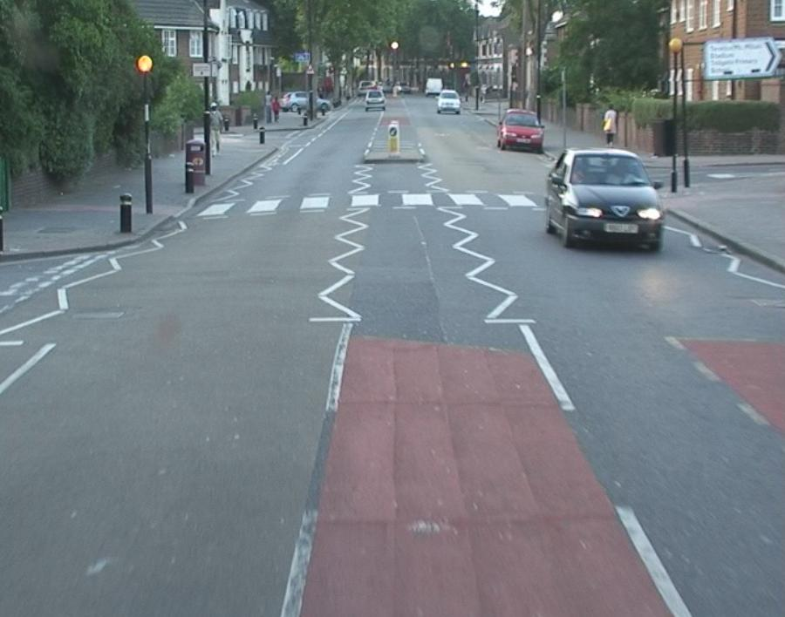
Advice given on factors to consider when establishing investigatory levels

Slide 12
Deficiency listing
Initial processing of data indicated 39% overall deficiency (below IL)
1,122 lane km of sites
16,661 separate locations/ events
Concern about capacity to undertake investigations
Need to develop tools to prioritise sites
3 year crashes fitted to network and processed with SCRIM data
Notes:
Significant discrepancy between borough
Best (Kingston) 19% deficiency – 46 P1,P2 and P3 sites
Worst (Enfield) – 59% deficiency – 224 P1, P2 and P3 sites

Slide 13
Prioritisation model

Slide 14
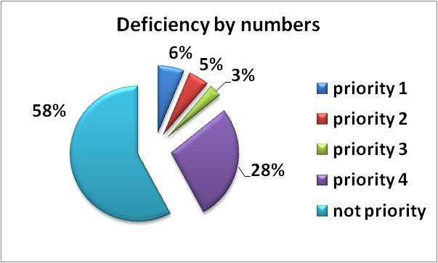
2010 site priorities
Notes:
87% of the P1 sites are ‘approaches’
73% of these have just 1 wet crash

Slide 15
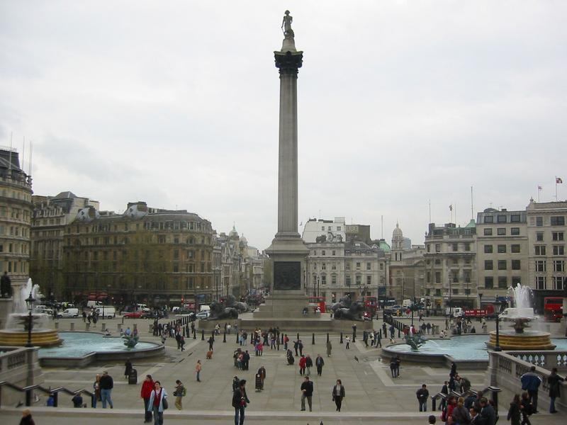
Deficiency listing
Separate lists for each borough/ TfL
Updated annually with SCRIM survey and 1 year of crash data
Provided as listing and GIS layers
Boroughs encouraged to set investigation standards
No of sites
Extent of deficiency
Priority sites

Slide 16
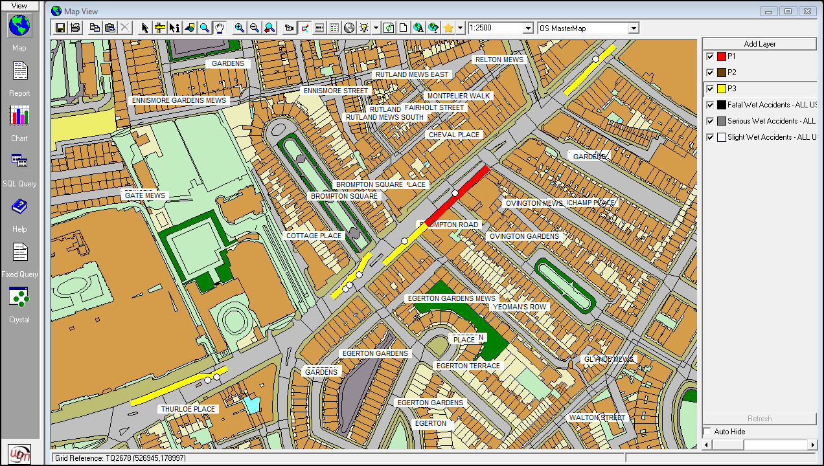
Example Deficiency Map
Notes:
Sample from TFL – A4 through Knightbridge

Slide 17
Pan London listing
Desire to establish method to allocate centrally held funding to TfL and 33 boroughs
Concern that the deficiency listing identified priority 1 sites with 1 accident where case to treat was marginal
TFL allocate funding and required transparency
Methodology agreed with project board

Slide 18
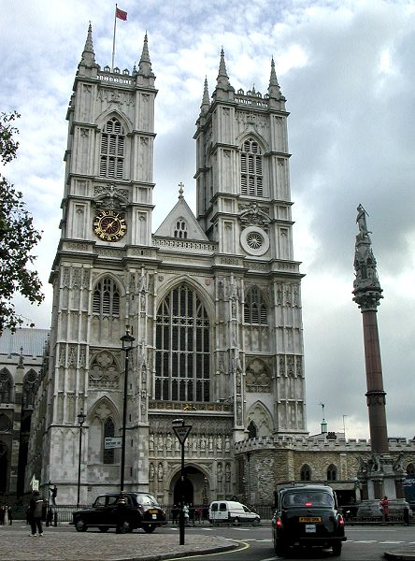
Pan London listing
Methodology considers
SCRIM deficiency
Wet crash numbers
Dry crash numbers
Crash severity
Site length
Traffic flows
To apply a site score to all the sites listed in London
Notes:
Weightings use
SCRIM def 35
Wet accident/km 30
Dry accident/ km 10
Number of KSI 25
Traffic 5 ( final sort for otherwise equal sites – low traffic flows score more highly)

Slide 19
Benefits of the skid policy
Site Category | Network level |  | Targeted approach SC ≤ IL-.1
 | Accidents saved in 10 years | First year rate of return - % | Accidents saved in 10 years | First year rate of return - %
Approach to pedestrian crossing | 827 | 21 | 635 | 42
Approach to junctions | 690 | 74 | 298 | 188
Approach to roundabout | 55 | 67 | 50 | 148
Gradient 5 – 10% | 9 | 22 | 4 | 58
Single bend < 100m | 68 | 300 | 56 | 503
Single bend >100<250 | 16 | 27 | 8 | 65
Dual non event | 32 | 11 | 4 | 56
Single non event | 27 | 4 | 15 | 15

Slide 20
A Summary of the Process
Annual skid survey
Review site category and IL’s on 3 year cycle
Update crash data for current year and produce 3 year averages
Borough/
TfL databases
Programme for maintenance in priority order within funds available
Produce deficiency lists for current year
Update site category and IL’s
Investigate deficient sites in priority order within limits of resources available.

Slide 21
Conclusions
Evidence based approach to setting IL’s introduced
Methodology to prioritise sites London wide established
Resulted in fair allocation of funding from TfL
Individual highway authorities maintain their independence but within the strength of a single skid policy across London’s primary network.
Notes:
Various options tested

Slide 22
Thank you

