Slide 1
Case Study: Ran off the Road Crash Variation with Pavement Friction LTPP GPS 23-1001 and SPS 23-0500 Reduced Friction Effect on Safety
Jim Sherwood, U. S. Federal Highway Administration, Turner Fairbank Highway Research Center, Infrastructure Research and Development
Roya Amjadi, U. S. Federal Highway Administration, Turner Fairbank Highway Research Center, Safety Research and Development
Gerardo Flintsch, Center for Sustainable Transportation Infrastructure, Virginia Tech Transportation Institute

Slide 2
Long Term Pavement Performance Program
The objective of this research is to investigate the relation between safety and skid number with a case study:
27.55 kM (17.12 mi) on an Interstate NB was constructed in 1972 with an open graded friction course.
In June 1995, it was milled and overlaid with a dense grade asphalt concrete due to pavement deterioration.
LTPP, GPS-1 test section had a four year average friction number of 66 before the overlay, and 44 after the overlay.

Slide 3
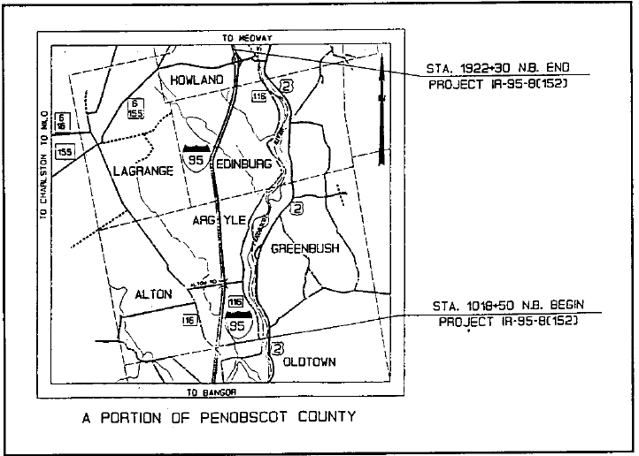
SPS 230500 and GPS Project 231001
Notes:
This map shows the limits of the overlay projectThe General Pavement Study

Slide 4
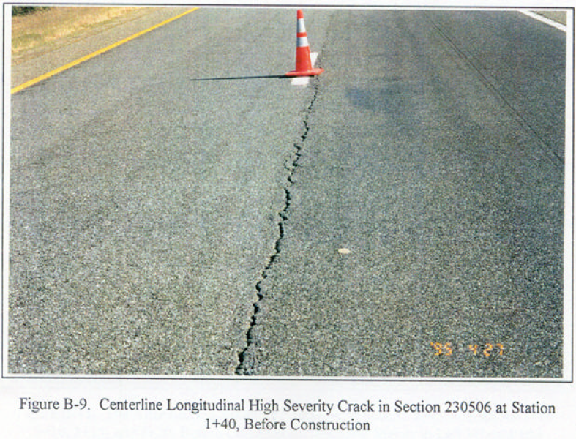
Pavement centerline cracks and bleeding “Before”

Slide 5
SPS Project 230500 “After” Overlay

Slide 6
SPS Project 230500 “After” Overlay

Slide 7
Gradation Curves for Asphalt Concretes

Slide 8
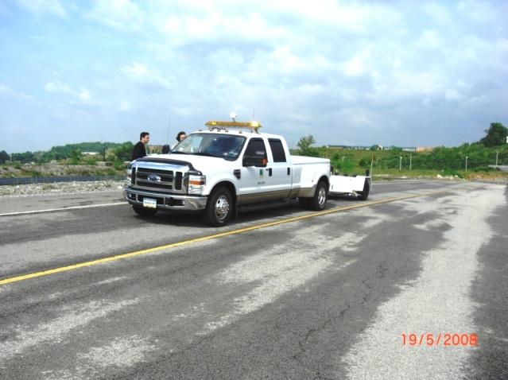
Friction Number “Before” and “After”

Slide 9
Data Sources
FHWA, Highway Safety Information System (HSIS) crash data files were used for this study:
Accident type (run off road, rollover, jackknife, rear end, object in road) and severity
Date and time
Location (nearest 0.1 mi. GIS MP)
Road surface conditions (wet, dry, snow/ice)
Number and types of vehicles.

Slide 11
Links have different lengths and AADTs
Link numbers, Lengths, Average AADT for Before and After
Link number | Length kM (mi) | Average AADT 1/1/85 to 7/1/95 | Average AADT 7/1/95 to 11/1/04
190908909090 | 3.03 (1.88) | 3536 VPD | 4222 VPD
190909009091 | 3.25 (2.02)
190909109092 | 3.77 (2.34)
190909209093 | 2.66 (1.65)
190909309094 | 1.30 (0.81)
190909409095 | 0.32 (0.20)
190909509096 | 4.25 (2.64)
190909609097 | 0.71 (0.44)
190909709098 | 3.93 (2.44)
190909809099 | 1.72 (1.07)
190909909100 | 2.11 (1.31)
190910009713 | 0.32 (0.20) | 2862 VPD | 3463 VPD

Slide 12
Methodology Did crashes increase in “After” period?
Compared crash rates for “Before” and “After” periods for each link.
Crash Rate (crashes per 100 million Vehicle Miles Travelled):
Crash Rate= (# Crashes x 10⁸) / (AADT x link length x days)
Note: Traffic volumes, speed limits, and number of lanes remained constant except for maintenance and rehabilitation.

Slide 13
After
Before

Slide 14
Methodology
Results show that crashes increased for “After” period.
Need to determine if crash increases in “After” period were related to lower skid number.
Wet pavement crashes were used to examine the low skid influence on crashes.

Slide 15
Methodology
To design the statistical analysis study two questions that need to be answered;
What type of crashes are directly influenced by wet Pavement?
How significant are crash frequency changes in “After” period?

Slide 16
Methodology
Used “Ran-off-road” crashes, and “wet” and “dry” pavement condition only.
Used crash Odd Ratios (OR) for After/Before for different pavement surface condition (i.e. dry, wet) to identify the magnitude of the crashes increase.
Odds <= 1.00 is not considered a “risk factor.”
Used Z-Test to compare proportions in “After” and “Before” periods for each type of surface condition (only for odds>1).

Slide 18
Study Period: 01/01/1985 to 11/01/2004 Total Crashes = 325 Before overlay Crashes = 142 After overlay crashes = 183

Slide 19
Study Period: 01/01/1985 to 11/01/2004 Total Crashes = 175 Before overlay = 64 crashes After overlay = 111 crashes
Accident type | Before (1/1/85-6/30/95) |  |  | After (7/1/95-11/1/04)
 | Dry | Wet | Total | Dry | Wet | Total
1. Ran off Road | 32 | 4 | 36 | 26 | 24 | 50
2. Rear end | 4 | 0 | 4 | 6 | 2 | 8
3. Rollover | 5 | 0 | 5 | 1 | 1 | 2
4. Jackknife | 1 | 0 | 1 | 1 | 0 | 1
5. Object in road | 15 | 2 | 17 | 47 | 2 | 49
6. Fixed object | 1 | 0 | 1 | 1 | 0 | 1
Total | 58 | 6 | 64 | 82 | 29 | 111

Slide 20
“Before” “ran-off-road” wet to dry ratio (4/32) = 0.125 “After” “ran-off-road” wet to dry ratio (24/26) = 0.92 “Before” “total” wet to dry ratio (6/58) = 0.103 “After” “total” wet to dry ratio (29/82) = 0.35

Slide 21
Conclusions
When a 23 year old open graded friction course was overlaid in 1995 with a dense graded hot mix asphalt concrete the four year average pavement skid number went from 66 to 44.
Reduced pavement friction after overlay is probably one of the factors that contributed to
39% increase in ran-off-road crashes, and
500% increase in ran-off-road crashes on “wet” pavement.
Increase of ran-off-road crashes on “wet” pavement in the “After” period is highly significant (P-Value= .00012)

Slide 22
Increased Crash Risk on a Wet Pavement Surface

Slide 23
Relative Risk on Wet versus Dry Pavement Surface
Before: On open graded friction course (1/1/85 to 6/30/95) if we assume the road surface is dry 88.9 % of the time, there is no increased risk of running off the road if the surface becomes wet:
After: On the dense graded overlay (7/1/85 to 11/1/04) if it is dry 88.9 % of the time, there is a 740 % increased risk of running off the road when the surface becomes wet:

Slide 24
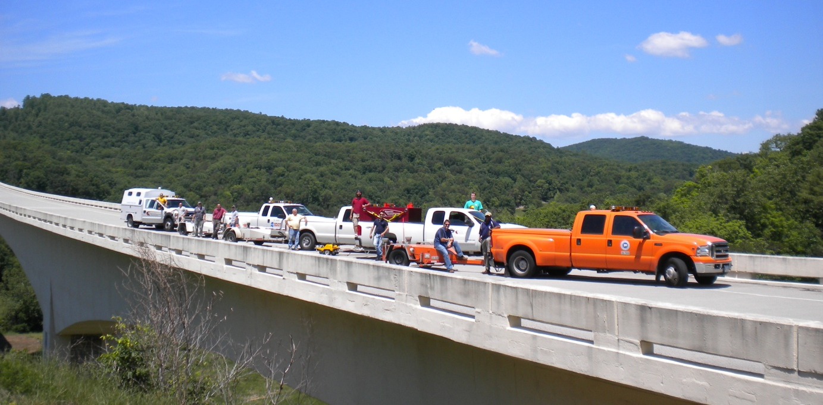
Thank you for your time and attention
Questions?
Jim Sherwood and Roya Amjadi
jim.sherwood@dot.gov
roya.amjadi@dot.gov
Gerardo Flintsch
flintsch@vt.edu

Slide 25
7th Symposium on Pavement Surface Characteristics SURF 2012
Norfolk, VA,
September, 19-21, 2012
Smooth, Safe, Quiet, and Sustainable Travel through Innovative Technologies
Deadline for submission of abstracts: July 31, 2011
www.SURF2012.org

