Slide 1
Failure Mechanisms of Special Surfacings

Slide 2
Non Slip Seal Coat – Christchurch Style

Slide 6
Aftershocks total = 2086 May 6 2011

Slide 7
Outline of Presentation
History
Failures
Modes of Failure
Adhesive Failure
Delamination Failure
Cohesive failure
Pavement Design
Solutions
Conclusions

Slide 8
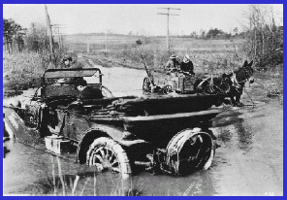
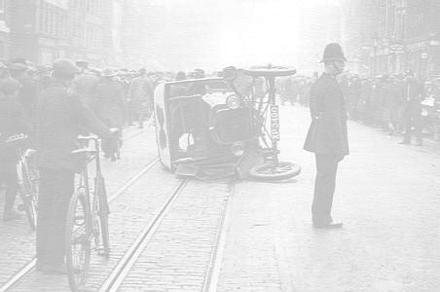
History
Early 1960s rapid increase in traffic
Crashes increase – Black Spots identified
Focus on surface condition
Develop high friction surfaces
Shellgrip in Christchurch in Early 1990s

Slide 9
HFS Failures
Application Failures
Adhesive failures and delamination usual failure modes
Existing surface contaminated
Bitumen
Road grime
Moisture
Dirty Aggregate
Wrong weather
Cure too slow
Cure too fast

Slide 10
Inconsistent binder application

Slide 11
Trafficking before the binder cured

Slide 12
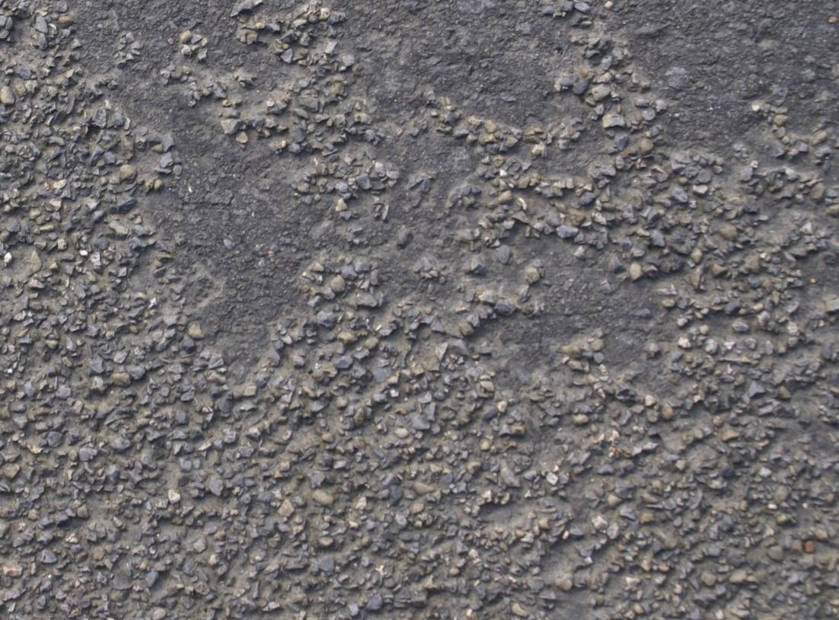
Chip loss from dirty chip

Slide 13
Delamination from water rising from below

Slide 14
Delamination due to bitumen rich surface

Slide 15
Delamination due to surface contamination

Slide 16
Delamination due to surface contamination

Slide 17
Cohesive Failure in asphalt

Slide 18
HFS with Asphalt Attached
1-3mm Calcined Bauxite in Epoxy Binder.
AC14 Asphalt still attached to HFS

Slide 19
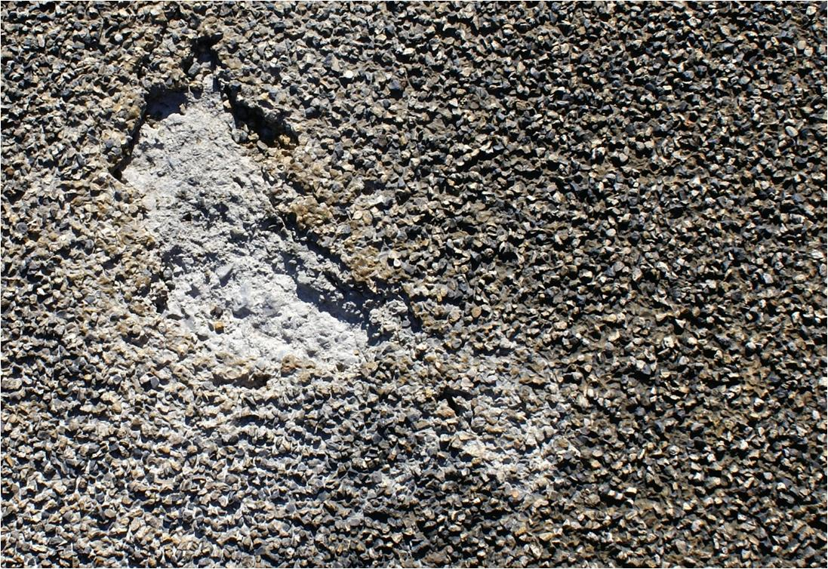
Cohesive Failure – Moisture?

Slide 20
Cohesive Failure within the asphalt
Possible causes
Water build-up under the HFS strips the binder
Expansion and contraction differentials
Stiffness differences
Shear stress too large
Asphalt too weak

Slide 21
Diagram depicting cohesive failure
Possible Cause 1
Water strips the binder
Reduces the internal friction of the asphalt
Asphalt fails at the high shear stress points

Slide 22
Diagram depicting cohesive failure
Possible Cause 2
HFS expands and contract at different rate
Small differentials crack the bonds
Asphalt fails at the high shear stress points

Slide 23
Diagram depicting cohesive failure
Possible Cause 3
HFS stiffer than asphalt
Asphalt deflects more breaking bonds
Asphalt fails at the high loading points

Slide 24
Diagram depicting cohesive failure
Possible Cause 4
Shear stress is transmitted into the asphalt
The asphalt internal friction too low
The asphalt fails at the high shear stress points

Slide 25
Diagram depicting cohesive failure
Possible Cause 5
Stress is transmitted into the asphalt by any or all of the above
The asphalt internal friction is too low
The asphalt fails

Slide 26
Pavement Design
HFS used on high demand sites
HFS used instead of realigning sites with poor geometrics
High demand pavements
International – 100mm AC on 200 – 300mm Structural Asphalt Pavement.
New Zealand – 50mm AC on Unbound Granular Pavement
Starting to see some change to this.
NZ Economic Analysis does not include the cost of disruption to motorist or neighbours.
Cheaper to surface with high PSV aggregate in a thin asphalt surfacing than proper pavement and HFS

Slide 27
Solutions
Better Pavements
Better Asphalt Design
Better Asphalt Binders
Better HFS Binder

Slide 28
Better Pavements
Thick asphalt limits permeability
Thicker asphalt larger stone
Deeper stone anchors
Lower deflections less differential

Slide 29
Better Asphalt Design
Larger stone deeper anchors
Increased internal friction
Increased tensile strength
Reduced permeability

Slide 30
Better Asphalt Binders
Better asphalt internal friction
Asphalt handles stress better
Asphalt more durable when stressed
Binder more resistant to stripping

Slide 31
Better HFS Binder
Binder breathes like the asphalt
Binder deflects and expands and contracts like the asphalt
Better adhesion properties
Better and faster curing binder

Slide 32
Summary
Outlined the mechanisms of failure
Have offered some solutions
Still looking for the silver bullet
Any ideas to improve HFS lives welcomed

Slide 33
Thank you for Listening

