Slide 1
Correlation Between Laboratory and Field Performance of Greywacke aggregates
Qinxin Cao, Adelia Nataadmadja, and Dr. Douglas Wilson
Notes:
Good afternoon, ladies and gentlemen. Today I would like to present a research that introduces a new methodology to perform laboratory test to predict the performance of road surfaces. This methodology has been developed at the University of Auckland in 2006 and this research is the first research done to correlate the results to the field results, specifically results from local roads.

Slide 2
Overview
Background
Project Objectives
Methodology
Results
Conclusions
Further Research Direction
Notes:
First of all, I will explain the background of the research, project objectives. Continued with the methodology, results, conclusions, and further research direction.

Slide 3
Why is the research important?
ROAD SAFETY
Notes:
Why is this research important? Why is it necessary to correlate the laboratory and field performance of aggregates? To answer those questions, it is important to remember that all road safety engineers would like to have road surfaces that are able to provide adequate road friction at all times, in wet or dry conditions.
Before aggregates were placed on the road, those aggregates have been tested and their expected performance in field has been predicted. It is then important to ensure that the predicted performance of the aggregates is close to what will happen in reality. All of these are done to create a safer road.

Slide 4
Greywacke
Notes:
This research focuses on greywacke aggregates because greywacke is the most commonly used aggregate in NZ. This figure shows the performance of three types of greywacke aggregates. Each of them has different grain size range, degree of metamorphism, and mineral content. Therefore each of them would have different toughness and would perform differently in skid resistance performance. In this figure, we can see that PSV test, which is an end of test result, did not align well with the order expected.

Slide 5
Greywacke
G4 PSV=53
Notes:
Another research done in 2009 to test a medium grained greywacke (G4) that has published PSV of 53. The geological properties of this G4 is similar to G2.

Slide 6
Project Objectives
Correlating the laboratory and measured field skid resistance performance of the G4 Auckland greywacke aggregate
Comparing the field performance between the G4 Auckland Greywacke and a greywacke aggregate (G1) from another quarry in Northland of New Zealand (NZ).
Investigating a skid resistance related crash model for the G4 Auckland greywacke
Notes:
There are 3 objectives of this research. First, to correlate the laboratory and field performance of G4 type greywacke aggregate. Second, to compare the field performance of G4 and G1 type greywacke aggregates. Third, to analyse the skid resistance related crash model for G4 greywacke aggregates.

Slide 7
Methodology
Select roads constructed using G4 Auckland greywacke aggregates from RAMM database
Measure the skid resistance by using Grip Tester
Visually assess the macrotexture
Analyse the in-field results
Compare the
field and laboratory test results for G4 greywacke aggregate
Compare the performance of G4 and G1 greywacke aggregates
Relate the G4 greywacke aggregate
field results with crash numbers
Conclusions and Findings
Notes:
Here is the overview of the methodology we adopted in this research. We chose roads that were constructed using G4 greywacke aggregate from a database called RAMM. We went out to the sites, tested the skid resistance, and visually assessed the macrotexture. We tested 114 sites in total and all of our sites are local roads. State highways were not included because we didn’t have traffic control management. We also specifically chose geometrically benign roads to be included in this research.
Finally, the collected data is analysed, and compared against the laboratory result for G4 greywacke aggregate, against field result of G1 greywacke aggregate, and against the crash data.

Slide 8
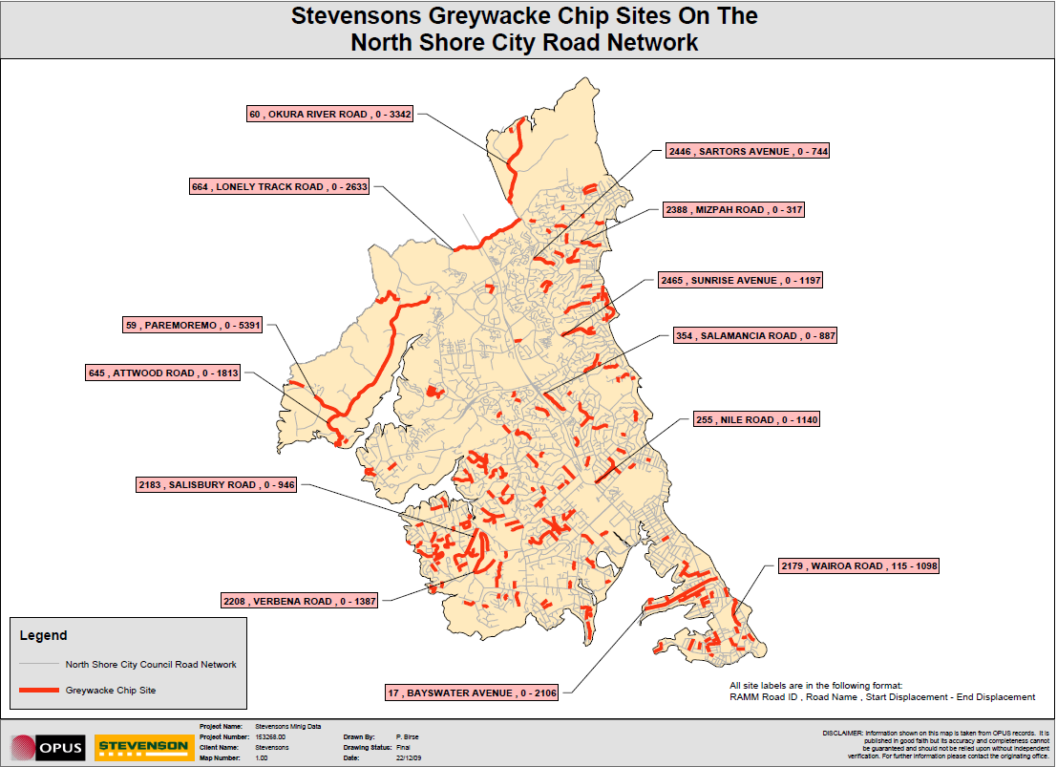
Notes:
Is this slide necessary?????
This is a map showing the roads in North Shore that were constructed using Stevenson’s greywacke aggregates. Their roads range from 2 to 5 years. We not only tested the roads in North Shore, but also tested the roads in Manukau and Papakura Auckland and Waitakere area
We tested 62 roads including 114 road sections

Slide 9
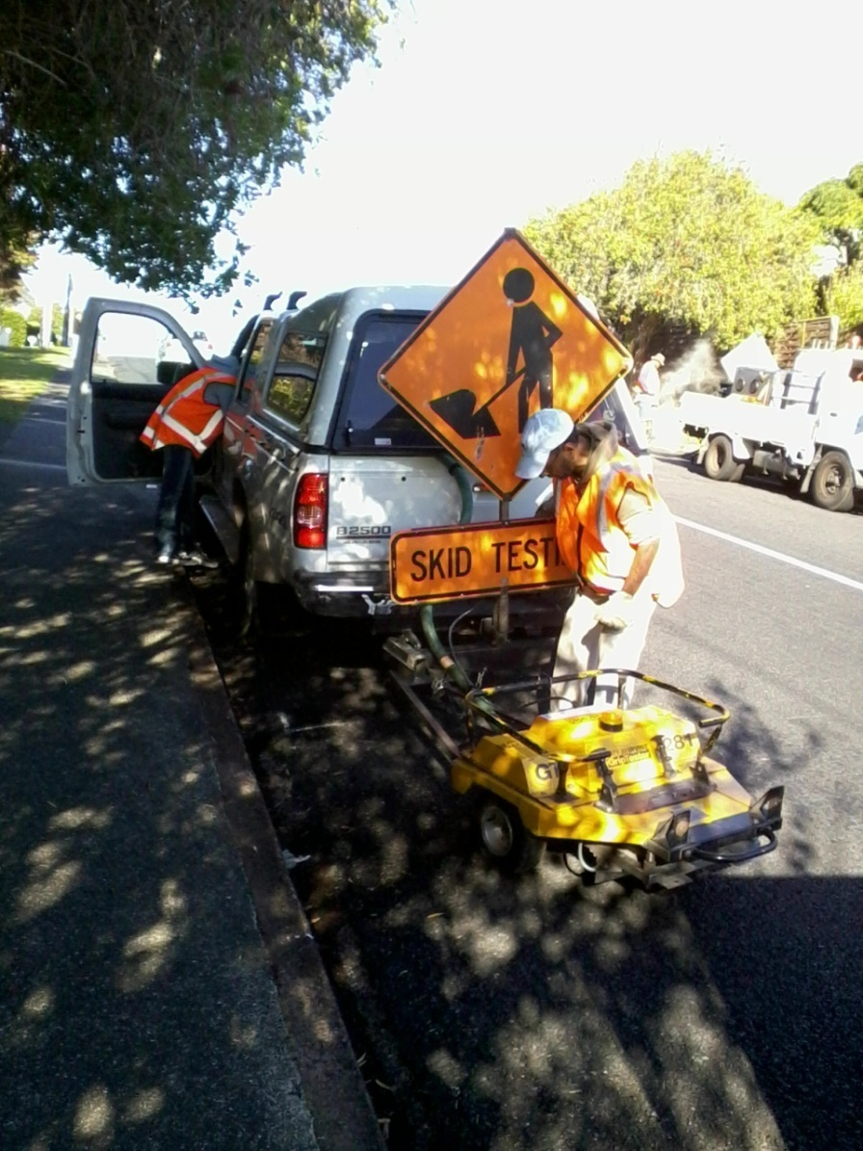
Skid Testing Procedures
2-3 runs
Run at 30-40 km/h
Calibrated every 2-3 days of skid testings
Seasonal Variations
Notes:
To ensure the validity of the data, we did two to three runs per site and we calibrated the GT after 2-3 days of skid testings. The Grip Tester was run at speed of 30-40 km/h.
We did the testings in April and July and we did not notice any significant difference between the results and hence we concluded that the effect of seasonal variation can be excluded from this research.

Slide 10
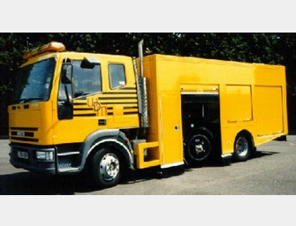
Northland G1Greywacke Aggregate
Source: http://www.epccn.com/en/productinfo448.html
SH 11
Source: http://maps.google.com/
Notes:
The field result for G1 greywacke aggregate was obtained from survey done in State Highway 11 (Northland), which was done by SCRIMM++.

Slide 11
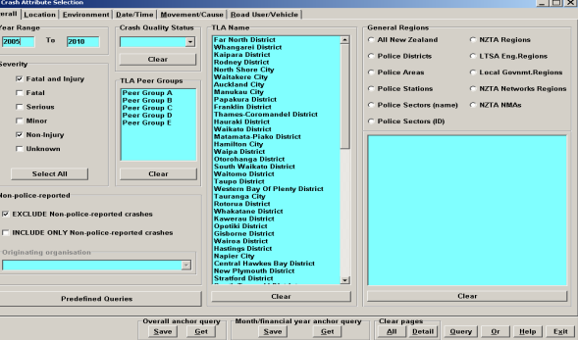
Crash Analysis Methodology
Input
Map
Define
Report
Notes:
Crash data was taken from Crash Analysis System, which is a database of all crashes occurred in NZ.
Specific case was taken when defining the year range of CAS input. We have chosen the cas period to be the time between surface date to GN test date. For the first site camden, it was surfaced in october 2004 and tested on july 2010, the actual age and cas period is the difference between the two.

Slide 12
Crash Data Analysis
Exposure
Relative Crash Rate
Notes:
These are the formulas used to calculate the exposure and relative crash rate.

Slide 13
Laboratory versus Field Performance
Laboratory Results (Kumar, 2009)
Field Results
Notes:
Now, we move to the results section. From these graphs, it can be seen that the laboratory and field performances have a very similar deteriorating trend. Even though the tests were done by two different devices (DFT for laboratory and GT for field), but the difference between the initial and final skid resistance is approximately the same, which is 0.2. (show next slide)
It can be noticed that there were reasonably wide range (0.45 – 0.72) in 2,3, and 4 years old surfaces. It could be explained by the difference in macrotexture quality of the road.

Slide 14
Laboratory and Field Performance
Notes:
From this graph, it can be seen clearer that the laboratory and field performances of G4 greywacke aggregates are similar (back to previous slide and talk about macrotexture).

Slide 15
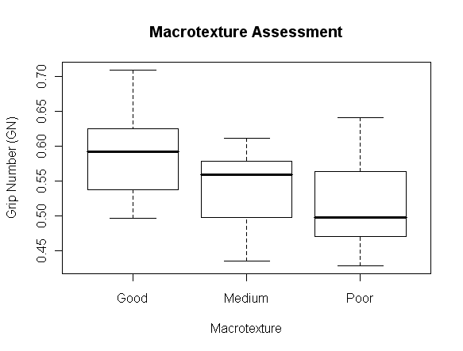
Macrotexture
Good
Medium
Poor
Notes:
The macrotexture was assessed visually and there was not definitive range of macrotexture. However, even so, the graph proves that the better the macrotexture, the higher the skid resistance

Slide 16
Traffic Polishing
Notes:
The analysis was extended to assess the effect of traffic volume or the polishing action done by Heavy Commercial Vehicles on the skid resistance. Previous researches have already proved that the more HCVs present on the road, the more polishing forces imposed on the road and hence the lower the skid resistance is. However, this graphs show that the skid resistance is not really affected by the traffic polishing.
It should be noted though that we tested local roads and with operating speed of 50-80km/h

Slide 17
Northland Greywacke Aggregates
Notes:
The laboratory performances of G4 and G1 greywacke aggregates are similar. It can be observed that after 7 years, the G1 greywacke aggregate performs equally well. However, it is difficult to observe any statistically significant deteriorating trend of the skid resistance.
There is a group of outliers noted in the graph. This outliers are unusually high for this aggregate source and it is most likely the skid resistance of different pavement surface type. It can be observe from the graph that the higher the macrotexture, the higher the skid resistance is.
Traffic polishing is not included in the analysis because the traffic volume and HCV composition in this road section are reasonably consistent.

Slide 18
Crash Analysis Results
Notes:
Out of 114 sites we tested, only 35% of them have had any crashes reported. Out of that 35%, only 11% of the crashes are related to loss of control and wet surface

Slide 19
Relative Crash Rate Against Skid Resistance
Notes:
This figure plots the relative crash rate against the Grip Number. Even though there are only 4 points in the graph, a deteriorating trend can be observed. This suggests that the lower the skid resistance, the higher the crash rate is.
The relatively narrow band of measured skid resistance reflects that G4 greywacke aggregate does not deteriorate much and is relatively stable over time.

Slide 20
Conclusions
The accelerated laboratory polishing prediction methodology developed at UoA by Wilson (2006) can adequately reflect the field performance as measured by the GT for G4 and by the SCRIMM++ for G1
The relative crash rate decrease exponentially with increasing skid resistance.
Macrotexture and microtexture measurements are important to adequately describe skid resistance field measurements
Notes:
So, in conclusion……………

Slide 21
Further Research Directions
Analyse single coat seal and asphaltic concrete type pavements
Extend the analysis to different road categories
Extend crash analysis to different aggregates types
Analyse geometrically variable road sections

Slide 22
Acknowledgements
Jayden Ellis (Stevenson Ltd)
Barry Larsen (Stevenson Ltd)
Ross Ashby (Stevenson Ltd)
Noel Perinpayagam (The University of Auckland)
Sujith Jose Padiyara (The University of Auckland)
Si Thu Win (Downer EDI)
Notes:
We would like to acknowledge these people for their contribution and help in this research.
Thank you

Slide 23
MAIREPAV 7 Conference, Auckland, NZ - Call for Abstracts now open….
AUCKLAND, NEW ZEALAND – AUGUST 27-30, 2012

Slide 24
MAIREPAV 7 Conference, Auckland, NZ - Call for Abstracts now open….
27-30th August 2012

