Slide 1
Mapping interfacial stress distributions to digital surface micro-topography
Phillip Millar, University of Ulster, United Kingdom
David Woodward, University of Ulster, United Kingdom
Shaun Friel, University of Ulster, United Kingdom

Slide 2
Fundamentally
Performance of a surfacing material is greater than the sum of the characteristics of its parts
Meaningful evaluation of performance based on the estimation of a single geometry?
Holistic relationship between the many variables is very difficult (historically) to evaluate and predict

Slide 3
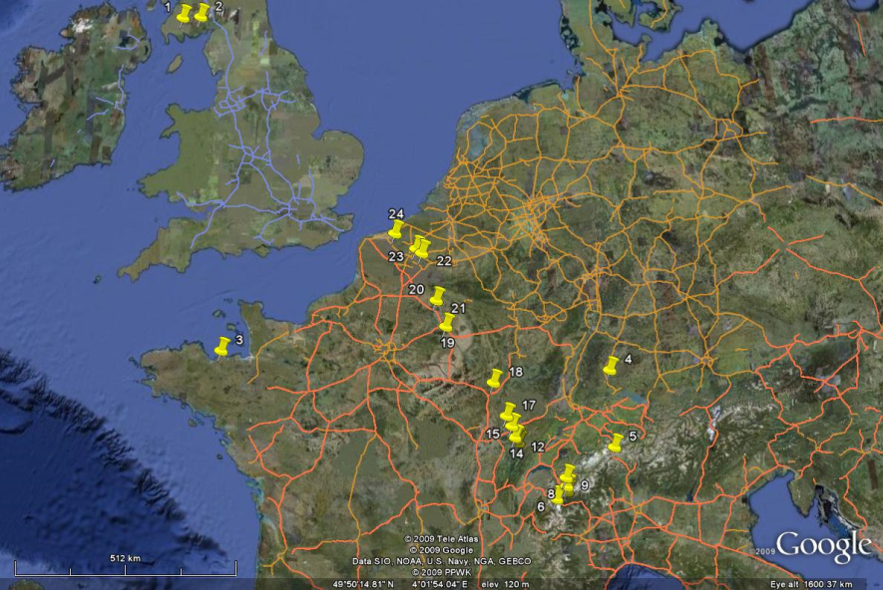
The Grand Tour (1)

Slide 4

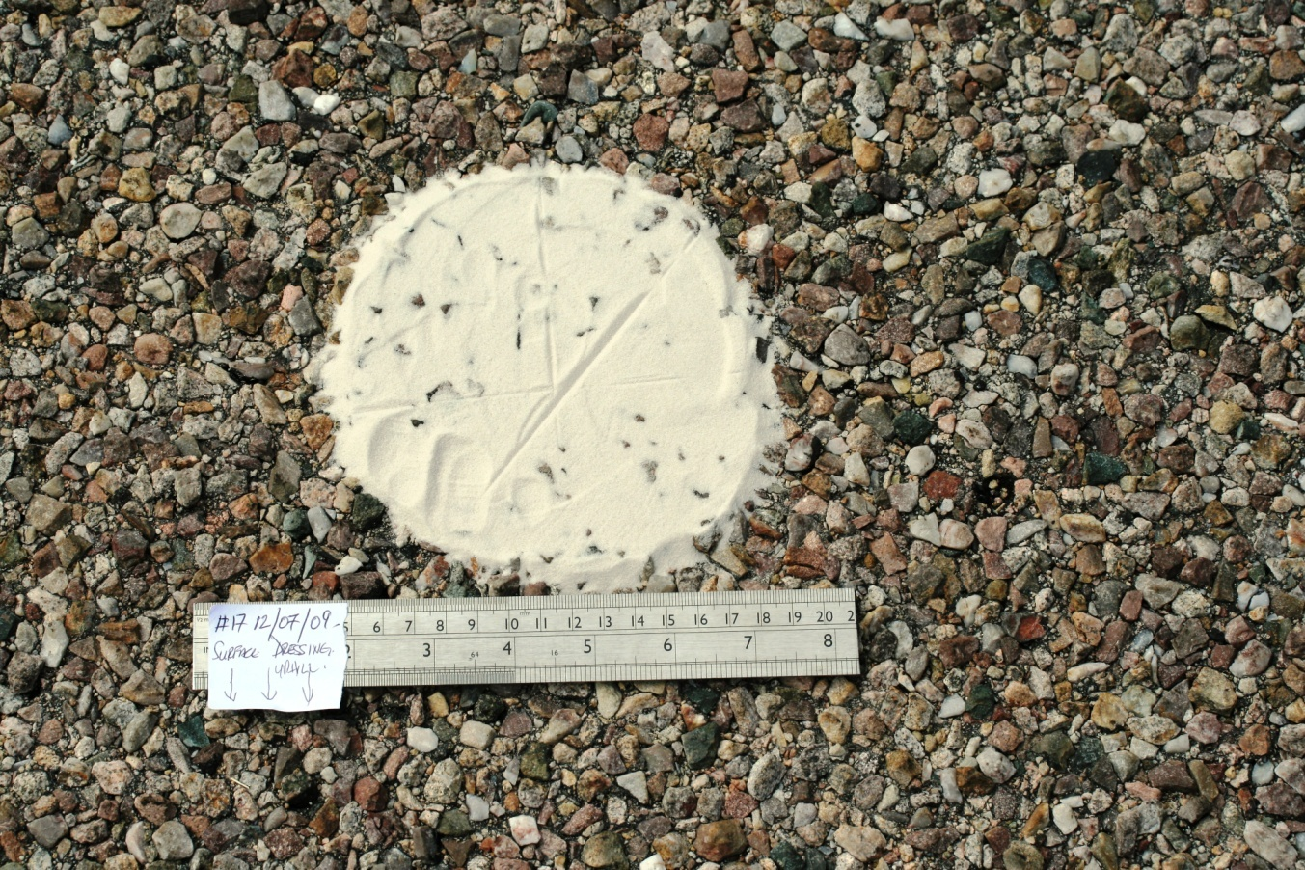
Hard Work!

Slide 5
Some Benefits of 3D Approach
Rapid data capture at source
Theoretically unlimited number of profiles in any direction or orientation facilitating assessment of:
  Deformation
  Wear
  Polishing
  Volumetric loss

Slide 6
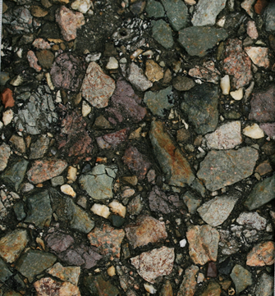
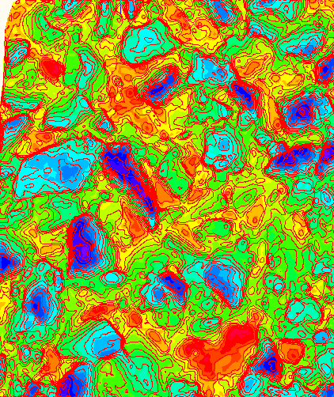
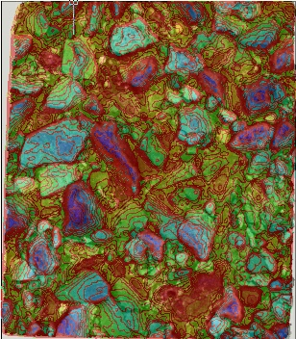
Processing Hierarchy
Ortho-rectified Stereo Image Pair
Depth banded and contoured 3D model
Depth banded model with raster overlay

Slide 7
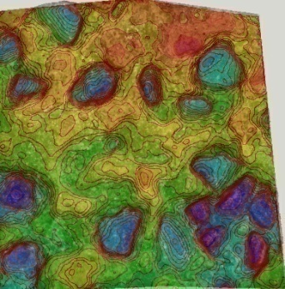
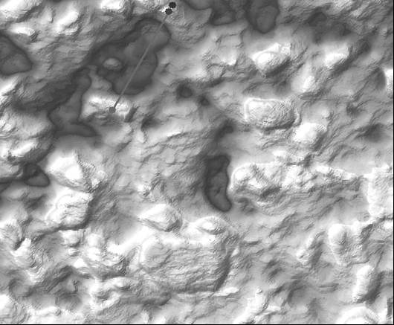
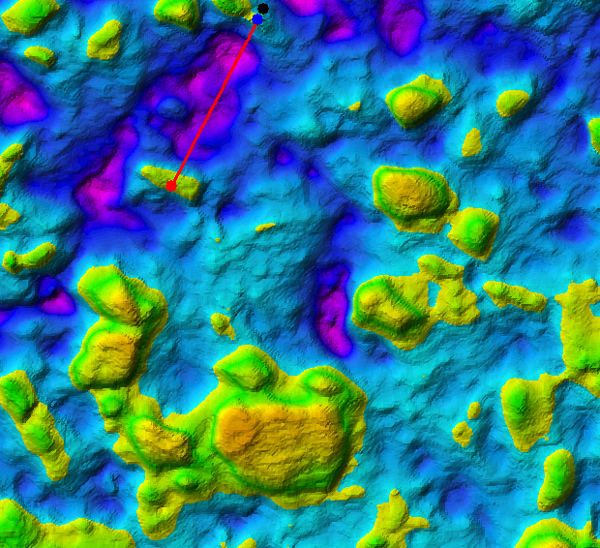
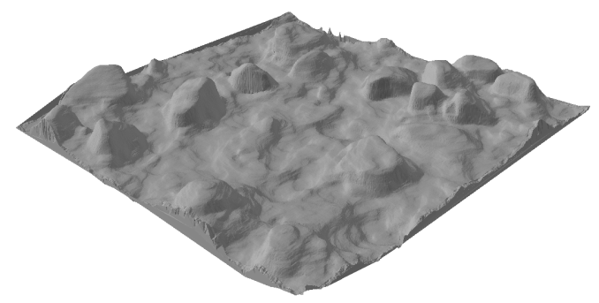
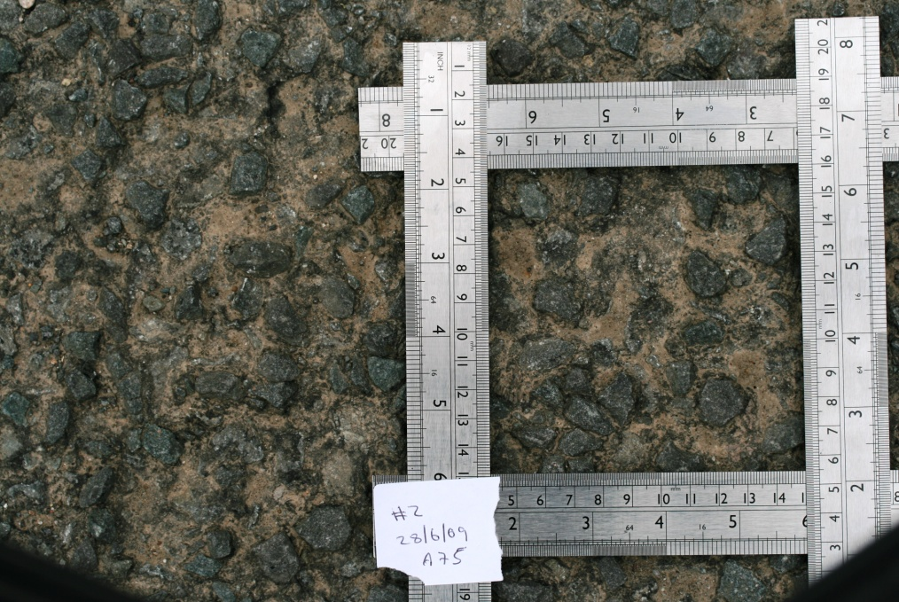
Depth Banded Models

Slide 8
Limitations of Single Geometry

Slide 9
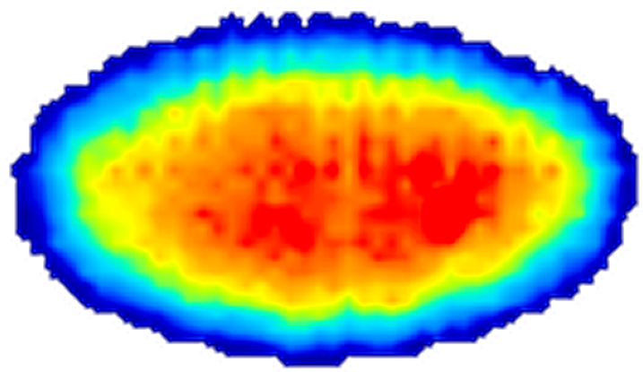
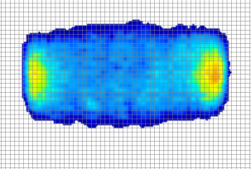
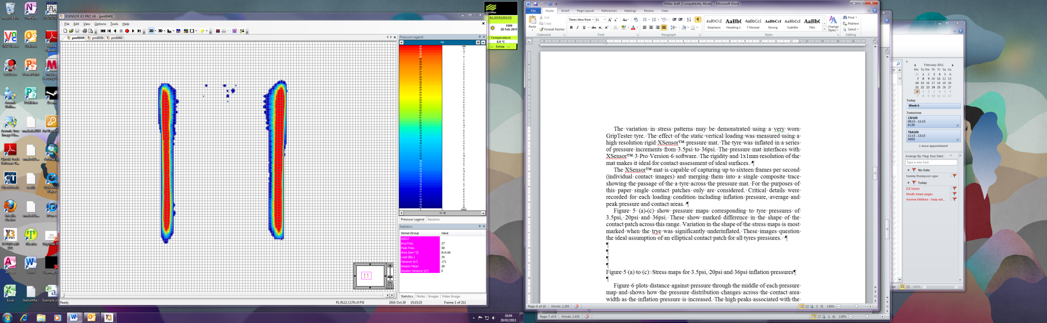
Interfacial Stress Mapping

Slide 10
Variation in Contact Profile

Slide 11
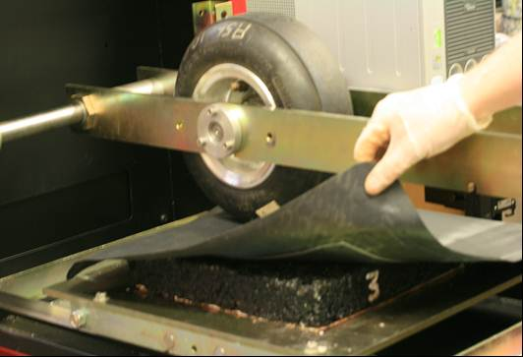
Development of Test Method
Modified Wessex Wheeltracker
Part worn GT Tyre
XSensor ® Flexible pressure mat
Interfacial membranes
305mm X 305mm slabs asphalt surfacing materials

Slide 12
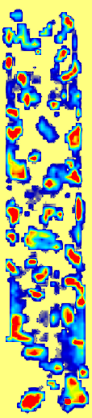
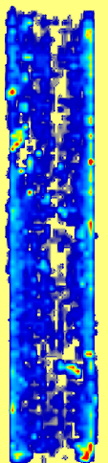
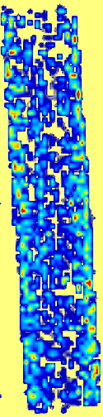
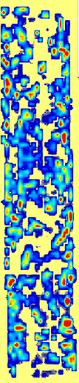
Example composite contact pressure maps for (left to right) chipped HRA, unchipped HRA, 6mm SMA and 14mm SMA

Slide 13
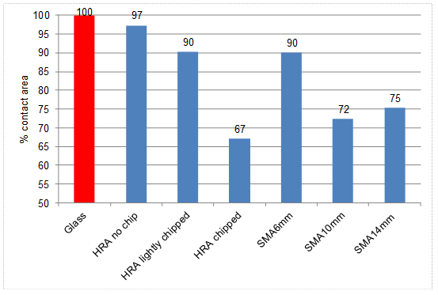
Percentage contact area related to a glass surface of 100% for 6 asphalt surfaces

Slide 14
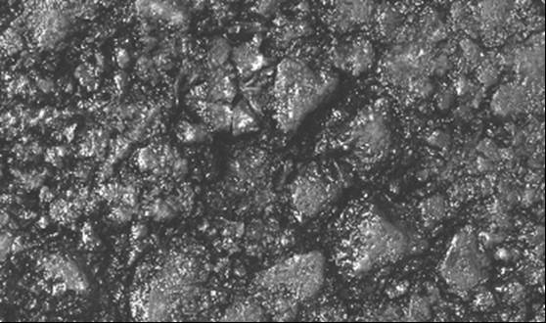
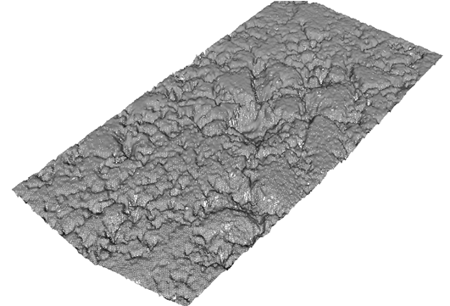
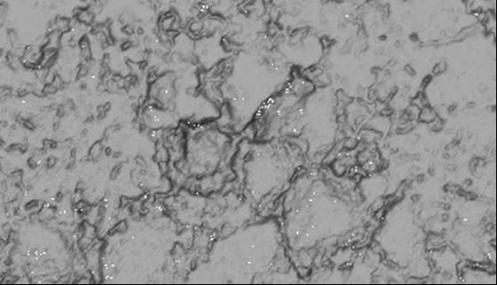
Ortho Rectified Stereo Images

Slide 15
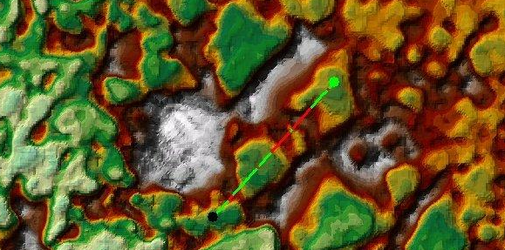
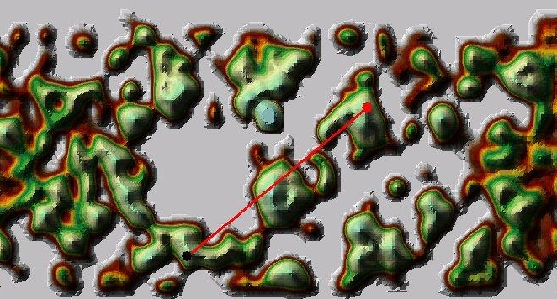
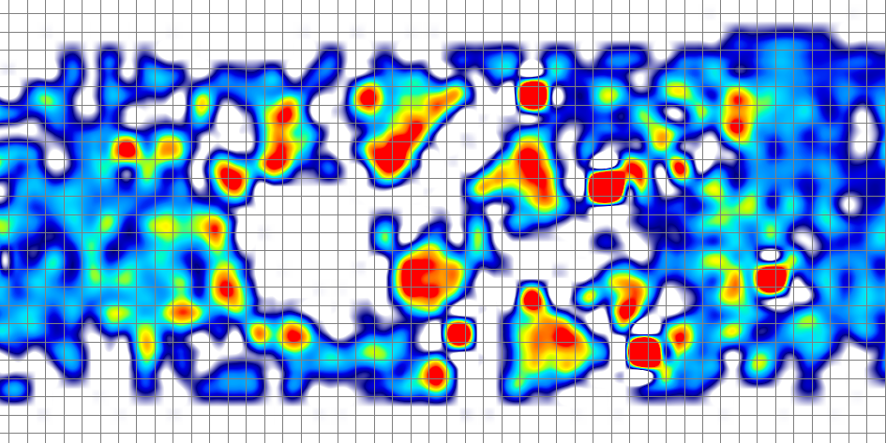
Mapping Pressure Distribution to Surface Topography

Slide 16
Significantly locally elevated pressure distribution associated with even slight variation in surface topography

Slide 17
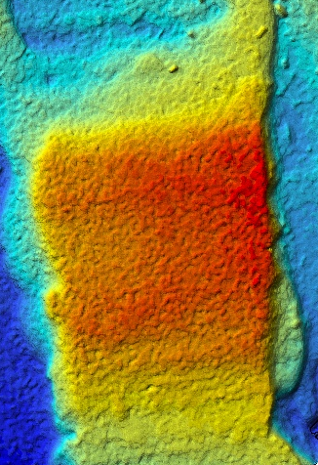
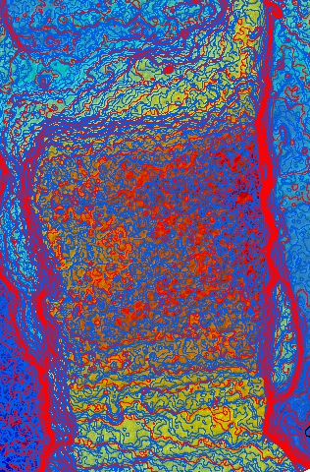
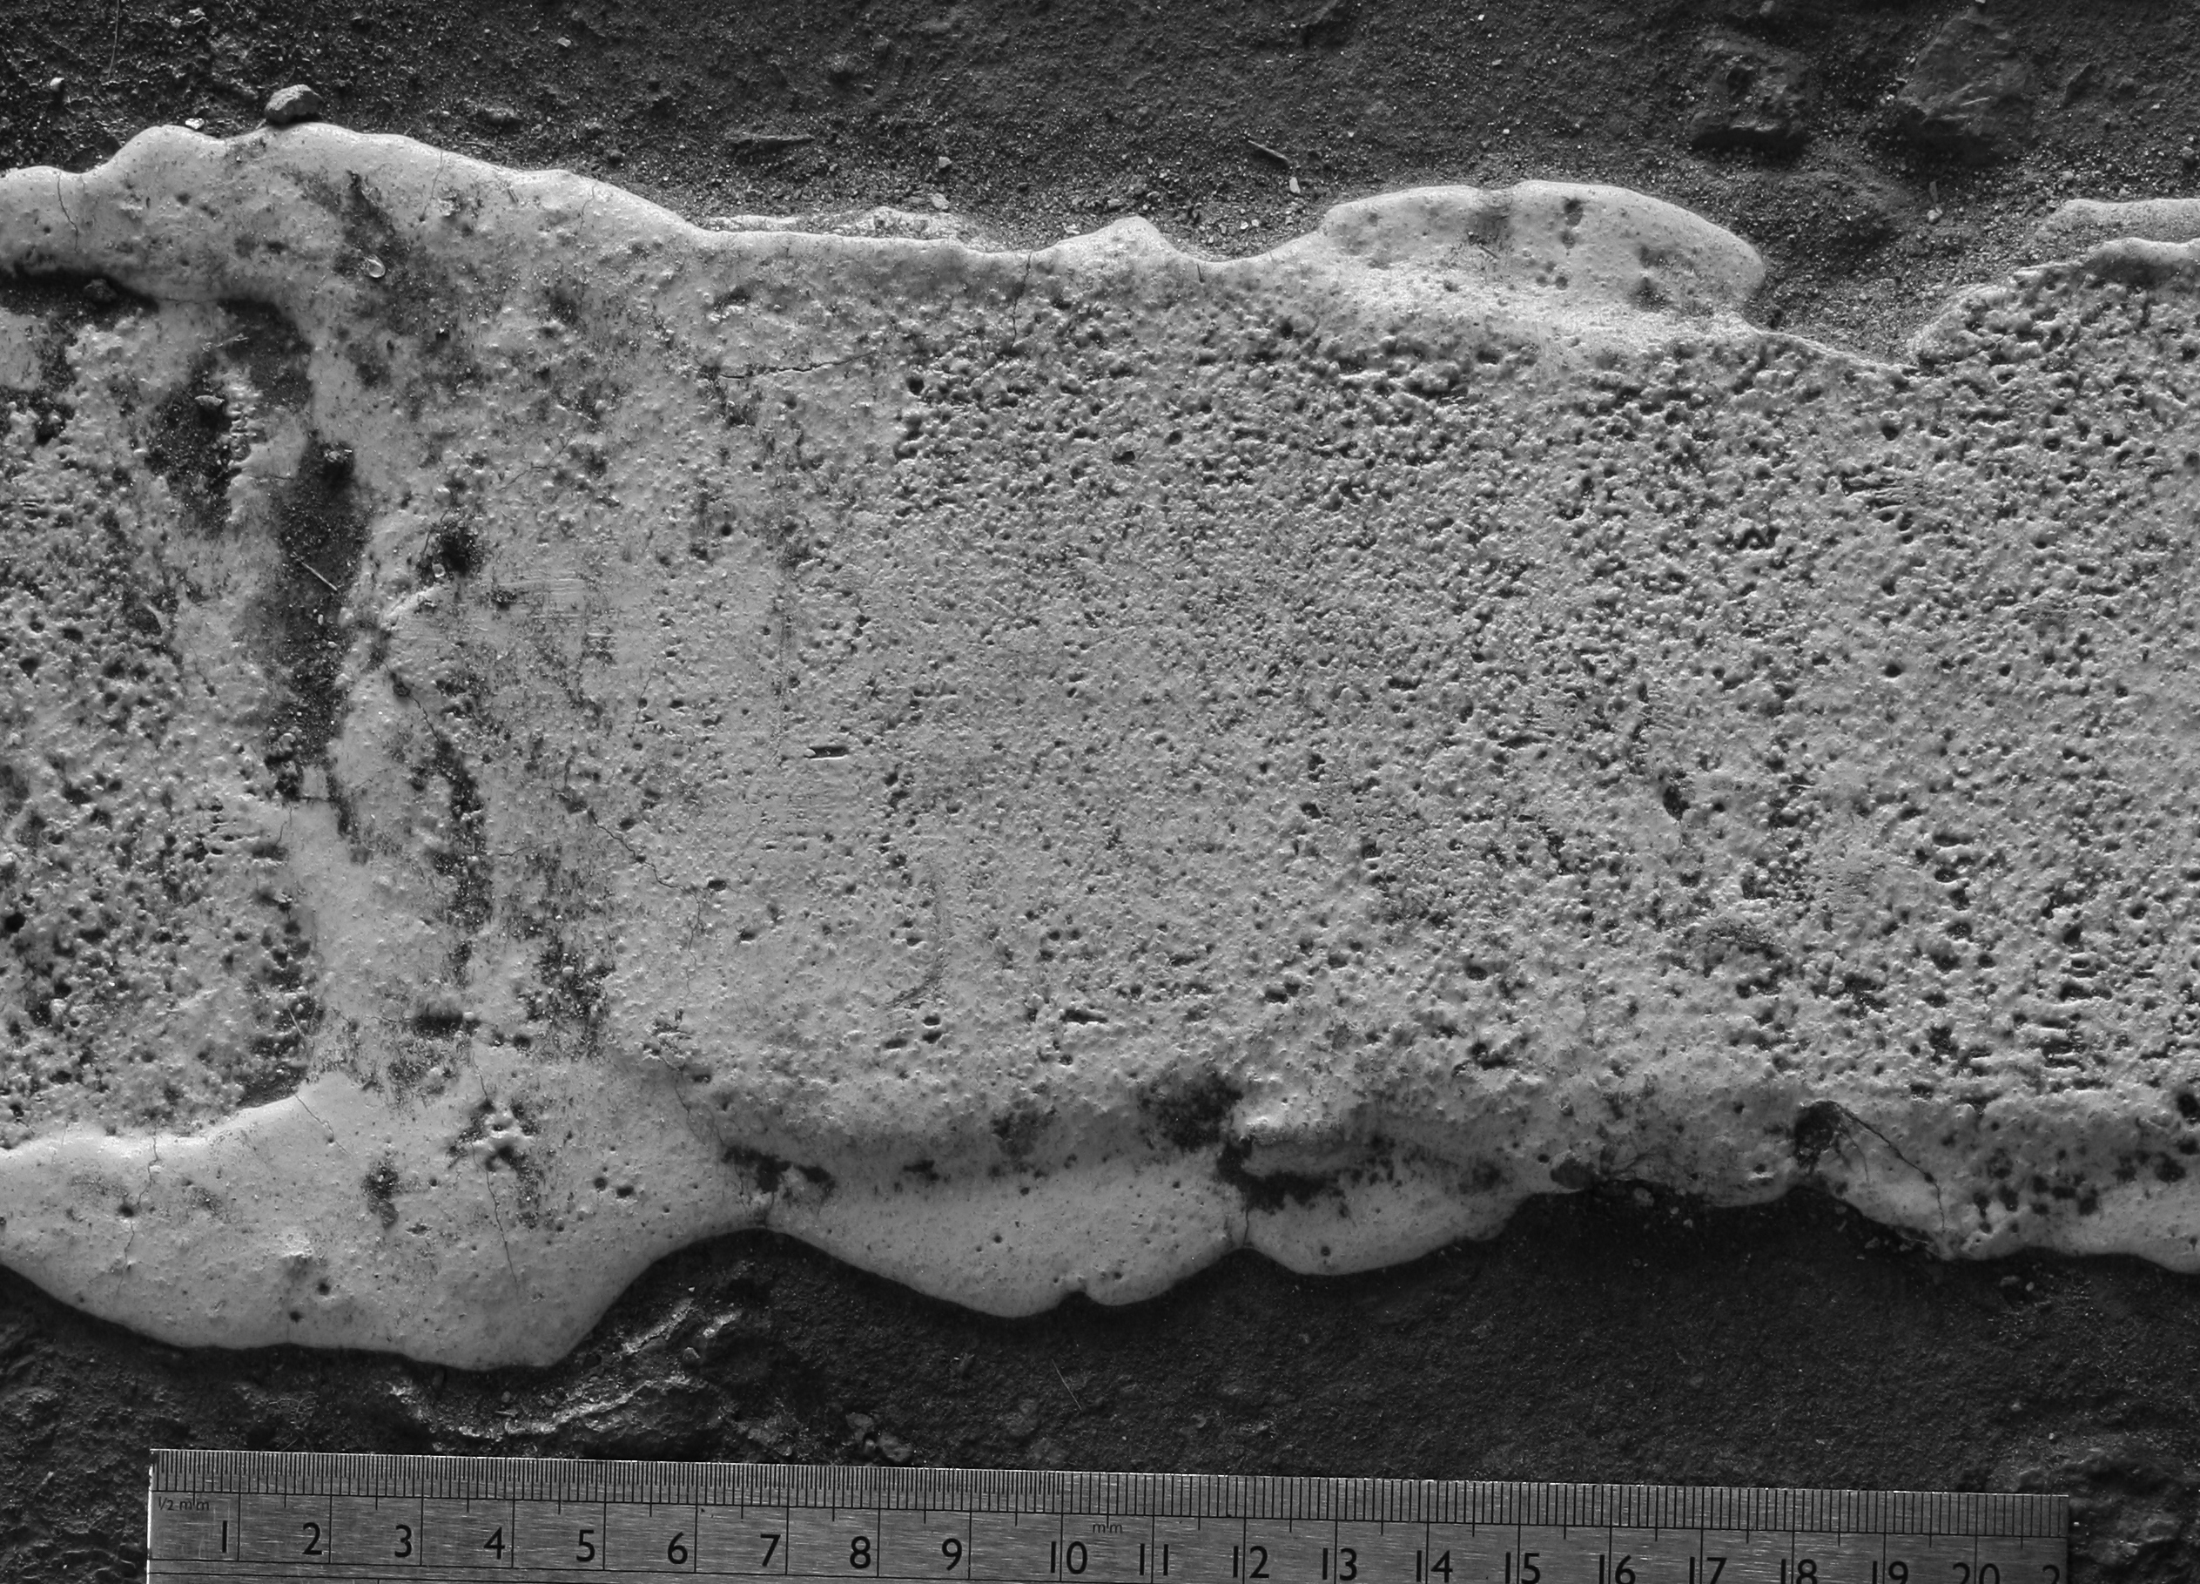

Slide 18
Conclusions
Methodology successfully maps interfacial stress to surface micro-topography.
New method of measuring static and dynamic contact patch phenomena
Combined interfacial stress and TIN mesh offers significantly greater insight to tyre/surface interaction.
Rapid drop in stress suggestive of tyre draping
Significant variation in contact area for different surface materials
Significantly elevated stress for even modest variation in contact topography
Significantly elevated stress around surface defects

Slide 19
Summary
Combination of tyre draping, local stressing, entrapped water and hydraulic pressures lead to selective weakening of asphalt surfacings and offers better understanding of long term durability.

