Slide 1
Skid Resistance Effects of Common
Treatments for Frost and Ice –
Mineral Grit and CMA
Neil Jamieson
Opus International Consultants

Slide 2
NZTA Research Programme
AIMS
To assess the level of risk associated with treating frost and ice with mineral grit or CMA
To develop input into ‘best practice’ procedures for winter maintenance – particularly timing of treatments
CMA – Calcium Magnesium Acetate (anti-icing / de-icing agent)

Slide 3
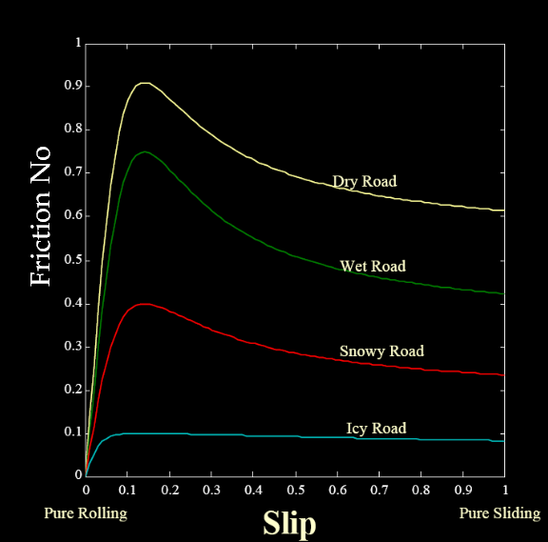
Frost and Ice
Why are we interested?
Why do we want to treat it?
Because of the effects on skid resistance

Slide 4
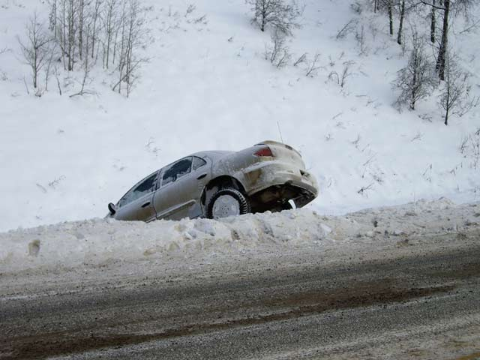
Consequences

Slide 5
What Can We Do About It?
Do Nothing! – Not Desirable
Treat It
What with?
When ?
What are the risks to road users?

Slide 6
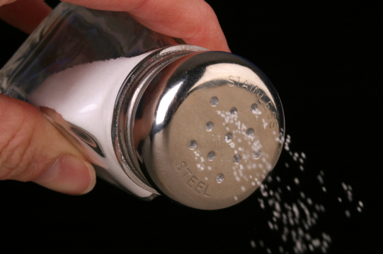
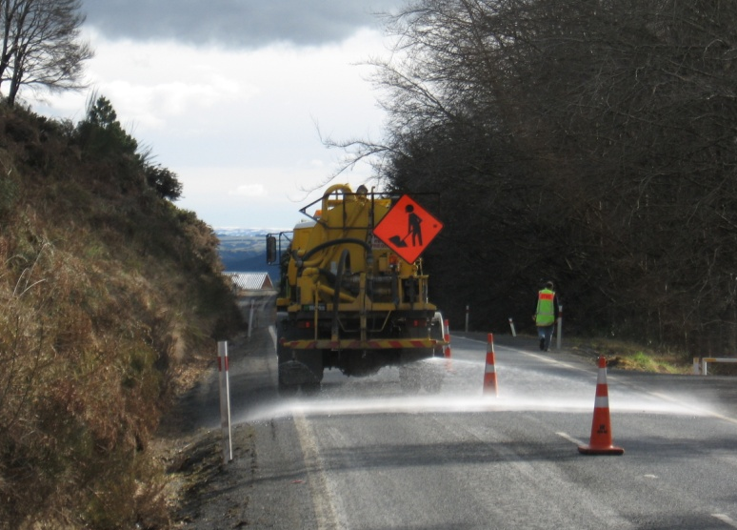
Treatment Options – New Zealand
Salt - discontinued in the 80s
Mineral grit - has been used for decades
CMA - use has increased since a review in 1996

Slide 7
Why Use CMA?
Because it WORKS?
Source: Whiting (2007)

Slide 8
Some of the things we didn’t know about Grit and CMA
Their effects on skid resistance, across the range of New Zealand road surfaces
Their effects on skid resistance immediately after application, and their performance with time
Their effects under different environmental conditions, e.g. at different time of day, or under dewfall
The relative risks to road users of different treatments

Slide 9
Quantifying Risk
Know the variation of crash rate with skid resistance
Quantify the changes in skid resistance with different road conditions and treatments
Identify the exposure of traffic to different levels of skid resistance

Slide 10
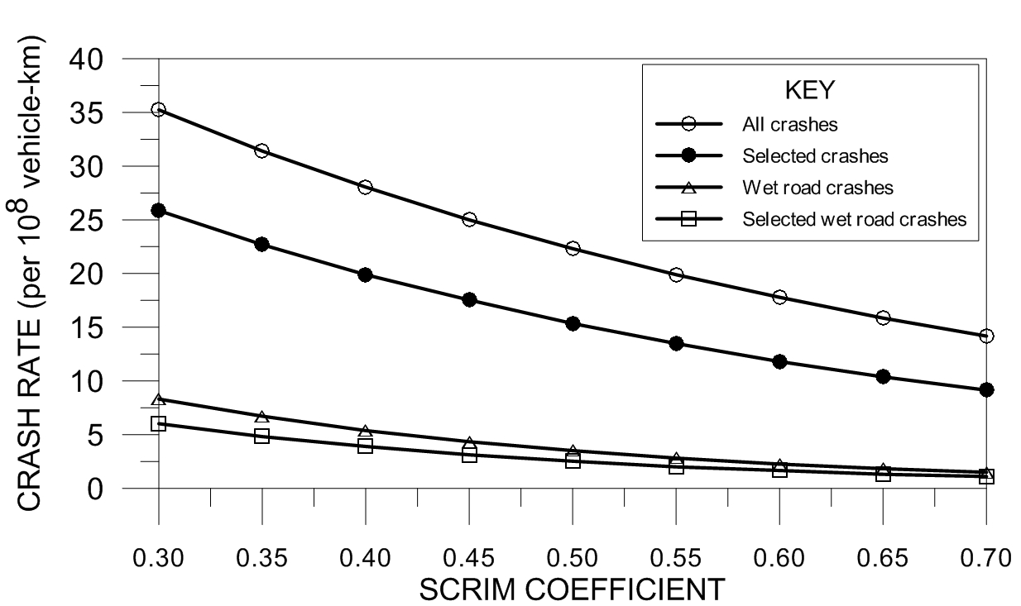
Crash Rate and Skid Resistance
Statistical analysis of fatal and injury crashes
Good correlation between SCRIM and Coefficients of Friction (CoF) from Locked Wheel Braking (LWB) tests

Slide 11
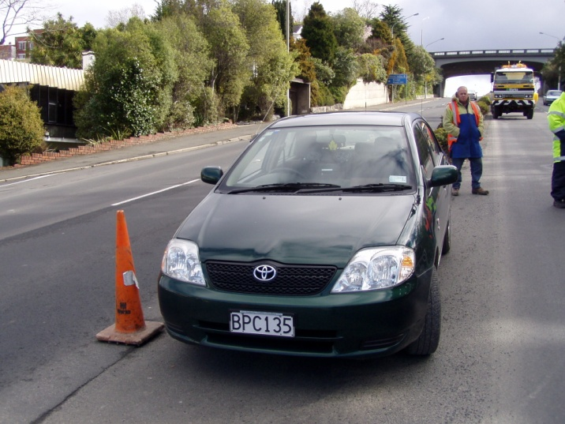

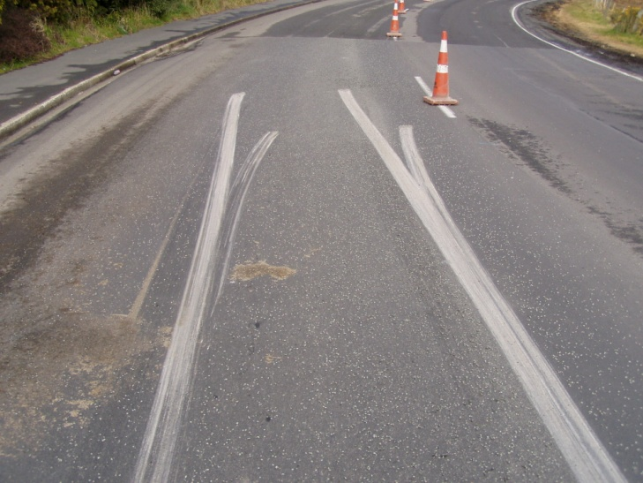
Quantifying Changes in Skid Resistance (1)
Locked Wheel Braking Tests
  7 sites
  different surfaces
  different traffic levels
  Dry
  Wet
  CMA
  Grit
  CoF
  Braking distance

Slide 12
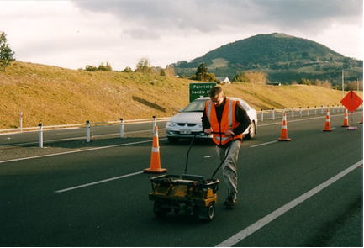
Quantifying Changes in Skid Resistance (2)
GripTester Measurements
  Push mode
  Dry
  Wet
  CMA
  Grit
  Wet + time
  CMA + time
  CMA + time + dewfall
  Grit + time

Slide 13
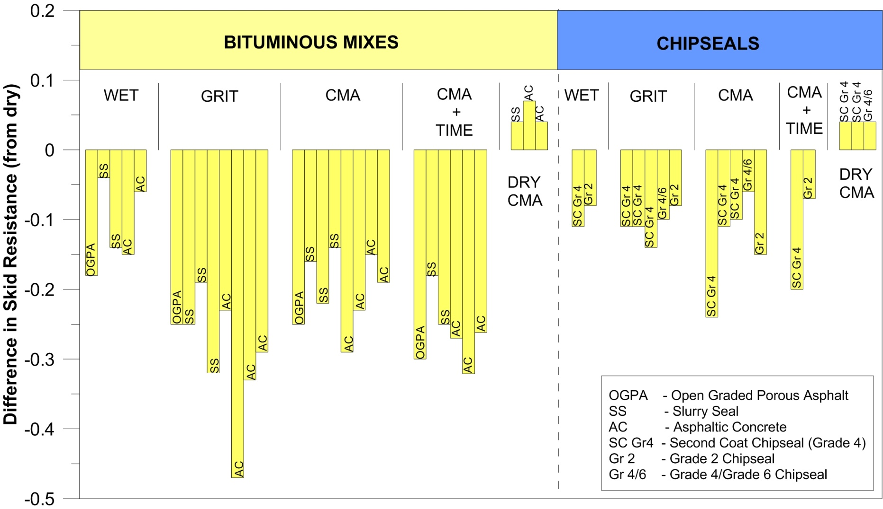
Results – LWB Tests (1)
Average difference in skid resistance from dry road
Notes:
Considerable variation between the treatments across the different surfaces and also across similar surfaces
All of the applications reduce skid resistance below that of a dry road, except for dry CMA
These reductions are generally greater on the smoother-textured asphalt surfaces than on the more textured chipseals
On the different surfaces, grit and CMA perform worst on the smoother asphalt surfaces
The performance of CMA can vary following application, depending on the environmental conditions
Dry CMA performs the same or better than a dry road with no treatment

Slide 14
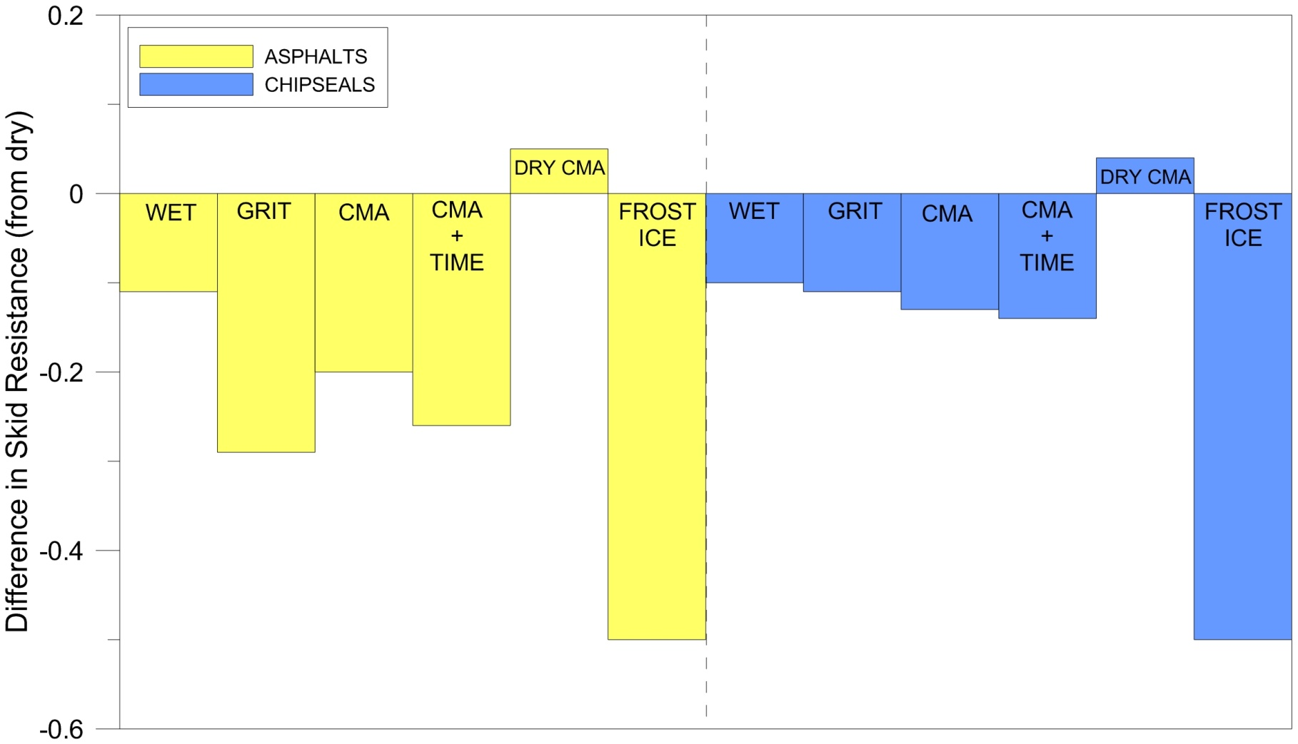
Results – LWB Tests (2)
Combined data for each treatment – asphalt and chipseal
Notes:
Average decrease in skid resistance on chipseals is generally the same for all treatments.
Not the case for asphalt surfaces.
This suggests that the tendency to put AC on high stress corners might need to be tempered in areas are prone to frost and ice
Have variation in crash rate with change in skid resistance, and the variation in skid resistance for the different treatments, so what information do we need to be able to assess the level of risk to road users?

Slide 15
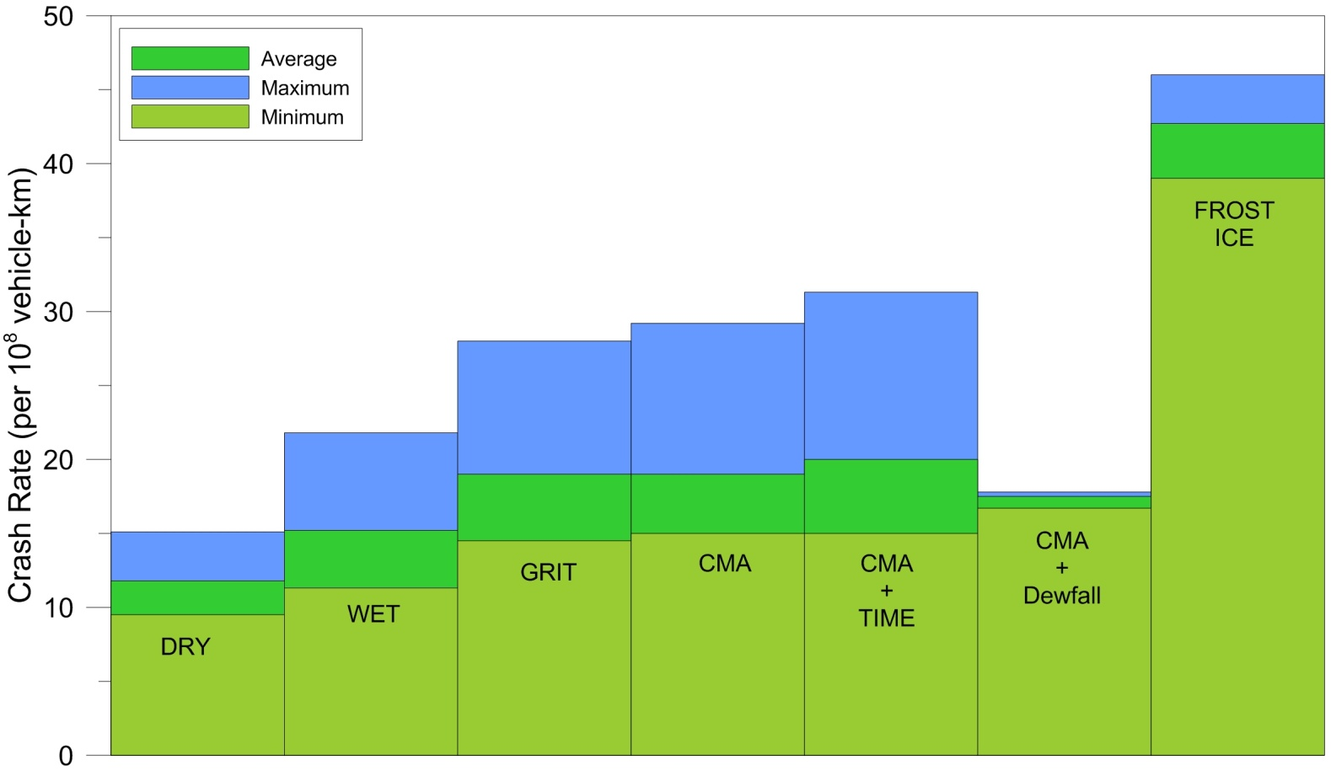
Calculated Crash Rates
Can now relate skid resistance changes to a crash rate

Slide 16
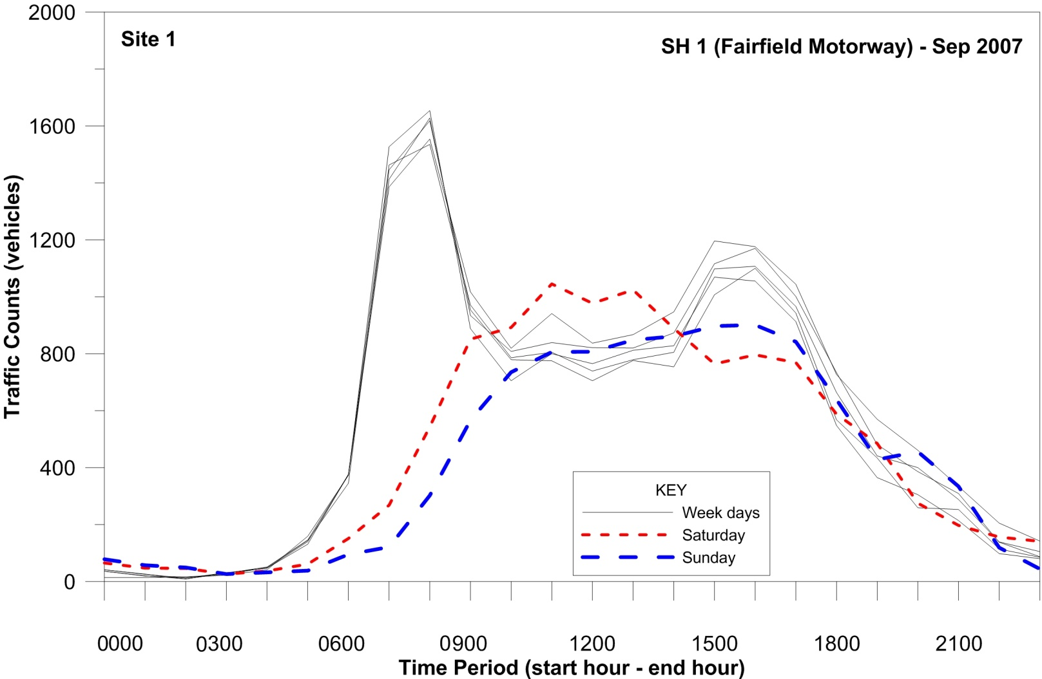
Traffic Levels
Typical variation of daily traffic
Notes:
Large differences in traffic levels can occur with time and day of the week.

Slide 17
Treatment Scenarios
Treatment event at 3pm, 6pm, 9pm and 12am
Treatments:
  Rain
  Grit
  CMA
  CMA – dewfall the night after
  Frost/ice
Notes:
To illustrate differences between treatments that might occur between mid afternoon and early the next morning different scenarios were considered.
It was assumed that the skid resistance changes lasted about 6 hours.

Slide 18
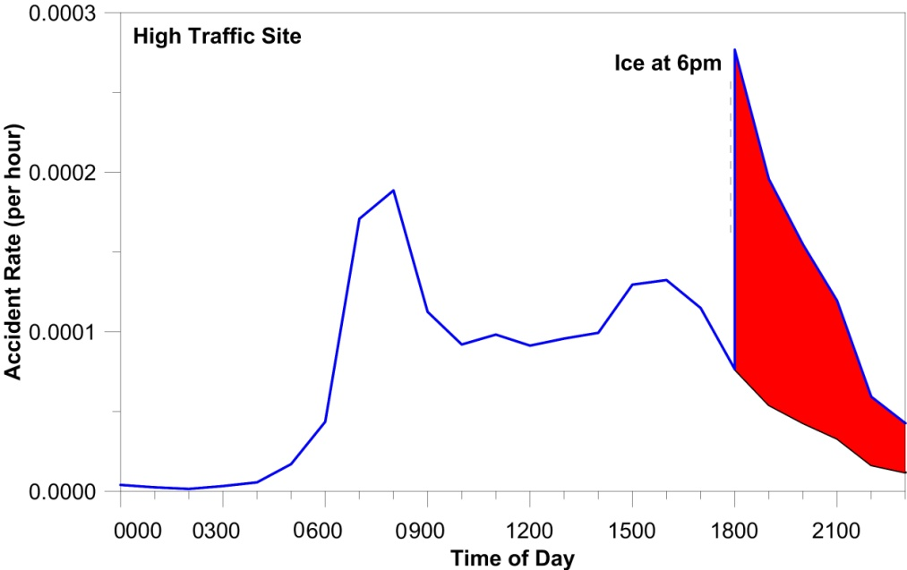
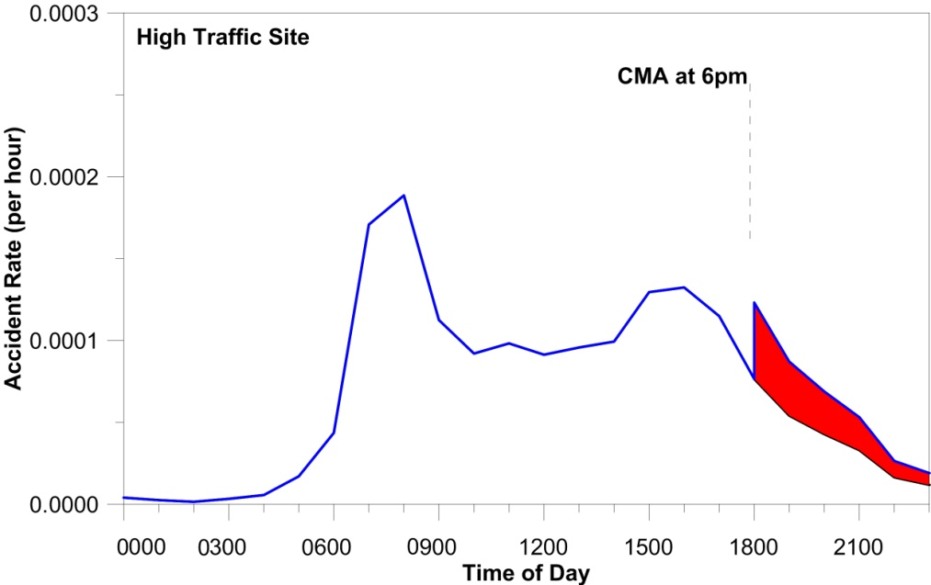
Ice at 6pm and CMA at 6pm
Notes:
CMA reduces the potential crash rate considerably compared to an icy road – regardless of the timing of the application
However, CMA does represent an increase in the potential crash rate over that of a dry road, until the CMA dries.
To asses the relative effects of each treatment-time scenario, the hourly crash rates were summed to give a net daily crash rate

Slide 19
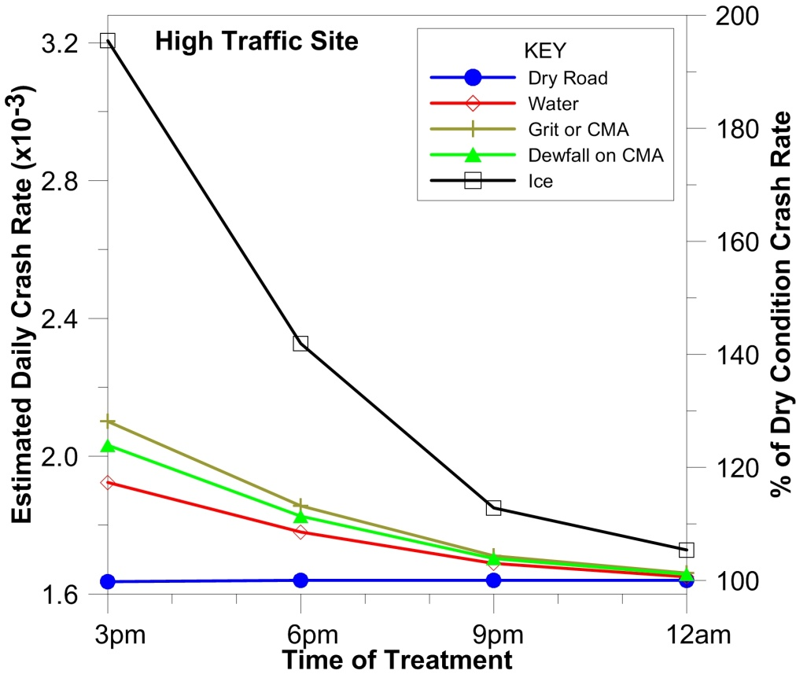
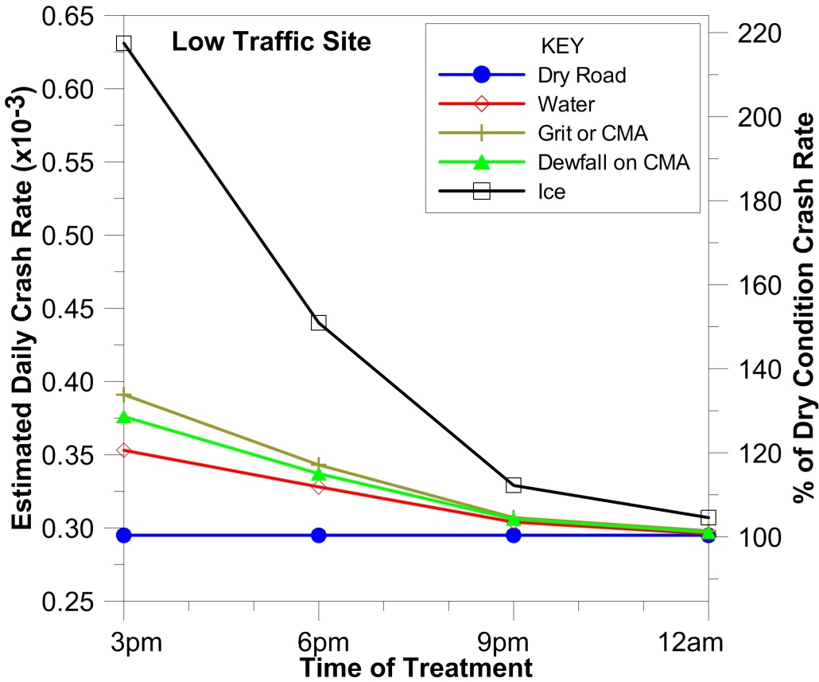
Estimated Daily Crash Rates
High Traffic Site Low Traffic Site
Notes:
The time at which a change in the road condition occurs, either through naturally occurring changes (rain, dewfall, frost and ice), or though application of treatments for frost and ice (grit or CMA), has a significant effect on the estimated number of daily crashes. As expected, when the treatments are made later in the evening, outside the rush hour period, when traffic levels are lower, the estimated daily crash rates are also much lower. After 9pm the overall daily crash rates for the two treatments for frost and ice (grit and CMA) are only slightly higher than those for a dry road, being less than 5% greater. They are also much lower than those for frost and ice conditions without treatment.

Slide 20
Timing of Treatments (Two Day Scenarios)
No treatment – no frost or ice
Frost/ice at 2am each night , lasting until 10am
Grit at 3am each night (reacting to frost/ice)
CMA at 12am first night in anticipation of freezing, no application next night, but dewfall on CMA already applied
CMA at 9pm first night (routine maintenance), no application following night, but dewfall on CMA already applied

Slide 21
Scenario Net Daily Crash Numbers
Estimated crash numbers – two days
Notes:
not treating frost or ice represents a very marked increase in the crash numbers
treating with grit, or with CMA, either before ice or frost is anticipated, or as routine maintenance at a specific time, reduces the crash rate per day considerably compared with frost or ice conditions
there is very little difference between applying CMA a short period before ice or frost is anticipated, or as a routine maintenance procedure at a specific time, provided routine application avoids the rush hour peaks
either application of CMA is better than an application of grit, given that grit is often applied after ice or frost has begun to form.

Slide 22
Concluding Remarks
Timing of treatment or change in road condition has a significant impact on the expected number of daily crashes.
Expected crash numbers were much higher for frost and ice than for any other road conditions or treatments.
Crash numbers were much lower when these condition changes or treatments occurred outside the peak traffic periods.
Treating road surfaces with grit, or with CMA reduced the crash numbers considerably compared to frost or ice conditions.

Slide 23
Concluding Remarks
Only 1–2% difference in the crash numbers between:
(1) applying CMA shortly before ice/frost was anticipated, (2) applying CMA as a routine maintenance procedure, provided this application avoided the rush hour peaks.
Either application of CMA was better than an application of grit, as grit is often applied after ice/frost had begun to form

Slide 24
Thank You
Neil Jamieson
Research Leader – Road Vehicle Interaction
neil.jamieson@opus.co.nz
Ph 64 4 587-0617

