Slide 1
Breaking the Silence
About Road Surfaces
and
Accident Rates
By R A Rallings, ME, FIE(Aust) CP Eng

Slide 2
Road Surfaces- Breaking the Silence Reasons for Paper
The silence distorts the public’s understanding of road safety.
2. Public’s right for reliable information.
3. Silence will not attract needed funds.
4. Opportunity to pose questions.
Notes:
1 The significant role that road surfaces play in accident occurrence and prevention has been missing from the mainstream dialogue on road safety.
2 Democratic right Low road friction is a public health risk should be treated with candour.
3. Questions are often a better way to make a point than argument

Slide 3
Road Surfaces- Breaking the Silence Scope of Paper
Tasmanian Select Committee on Road Safety.
Principles and tools of Risk Management.
WDM’s review of ILs for SFC in Tasmania.
Additional analysis of WDM’s data.
Engagement and ownership of ILs.

Slide 4
Road Surfaces- Breaking the Silence Legislative Council’s Committee on Road Safety
Seven (7) Terms of Reference
Road surface properties relevant to 3 terms
Committee received:
76 written submissions
83 oral presentations in 4 Australian states
Made 69 findings and 52 recommendations
Notes:
Term No 5 “ Means whereby road traffic crashes… may be reduced”.
Prior to my appearance before the committee, there had been 50 odd previous presentations
Do all those safety experts who made submissions disbelieve that surface properties are significant?
Why the silence/ obstacle to progress

Slide 5
Road Surfaces- Breaking the Silence ALARP Principle
Basic principle of Risk Management:
“ Risks should always be set at”:
As Low As Reasonably Practical
It requires demonstration that:
Sacrifice in reducing risks>> Benefits
Notes:
The AS handbook HB 436 provides a legal opinion of reasonably practical. I prefer to see it simply as is what we owe to those in our care”

Slide 6
Road Surfaces- Breaking the Silence *Site Categories -Investigatory Levels ILs
Manoeuvre Free Roadways
Site Category | Grade % | Horizontal Radius (m) | IL SFC
2 | => 5 | or < 250m | 0.50
4 (single) | <5 | >250m | O.40
5 (dual) | <5 | >250m | O.35
6 |  | =< 100m | 0.60
*Vicroads/ DMR (1995)
Notes:
The slide is an abbreviated extract from the Vicroads- DMR NSW Guidelines on the use and interpretation of SCRIM.
The slide is limited to the manoeuvre free carriageways.
Cats 4&5have the lowest grades and largest radii
Roads with the better geometric features have been assigned the lowest ILS, Looks like Equal risk???

Slide 7
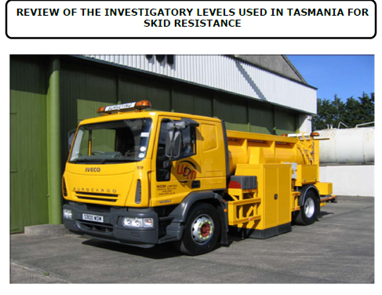
Road Surfaces- Breaking the Silence WDM’s Report
Notes:
Commissioned by DIER. Reported in 2008
The report did not include the data on which the figures included in the report were derived

Slide 8
Road Surfaces- Breaking the Silence WDM’s data- Tas Road Network
6300 lane km (100m sections)
2145 Wet road accidents (2003 to 2006)
6 site categories (single and dual)
3 sub categories in Cat2
Average Annual Daily Traffic (AADT)
10 SFC bands/bins from <0.30 to > 0.70
WDM/RAR
Notes:
WDM had undertaken SCRIM surveys of the Tasmaniann network for a number of years.

Slide 9
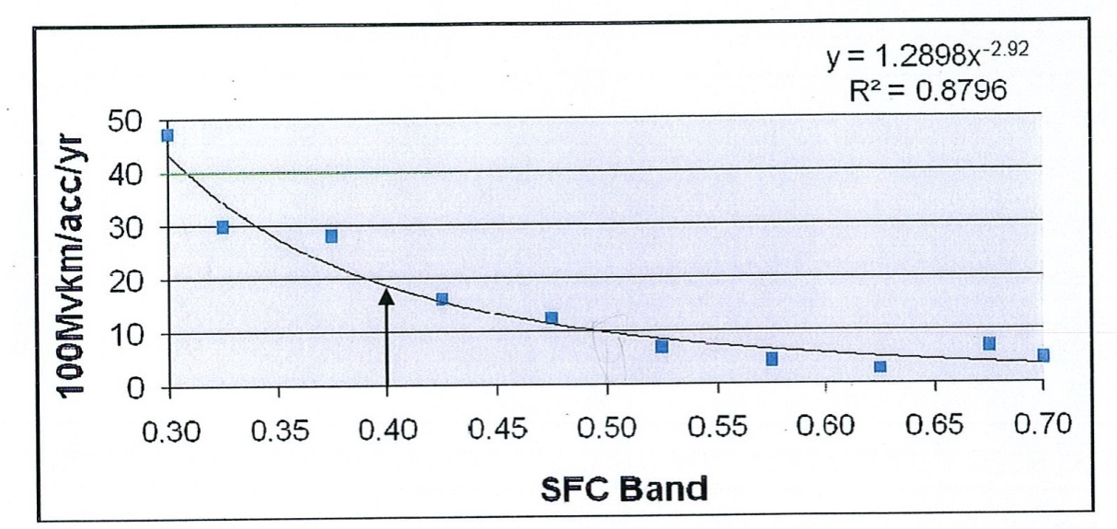
Road Surfaces- Breaking the Silence WDM, Site Category 4 - Equal Risk Policy
WDM
Notes:
Review included figures of this form for all the site categories.
The adopted policy for the setting of Ils was that the risk of an accident should be equal throughout the network.. The target accident rate at each IL was to be the wet road accident rate recorded for Cat 4 at an SFC of 0.40. As shown in the slide this rate is a little less than 20 per 100 million vehicle kms.

Slide 10
Road surfaces- Breaking the Silence Ils derived from Equal Risk Policy
WDM ,RAR
Notes:
Plots log of Wet Road accident Rate against SFC.
The equal risk policy seems to be contrary to the ALARP principle and in some ways to common sense.
If it is practical to set an IL of 0.50 for a Cat 2 road why is it not reasonable and practical to set the same limit for a Cat 5 road. The likely result of the increase in the IL to 0.50 will be a 50% reduction in accident rates, fro 20 to <10.
Dual carriage ways will normally have many inbuilt and expensive safety features. Why intentionally compromise these features by setting a low IL, simply for the purpose of creating an equal risk throughout the network???

Slide 11
Road Surfaces- Breaking the Silence Variation in Accident Rates in Cat 2
Notes:
WDM broke Cat2 into 2 subcategories
There is a 3 to 4 fold variation in average accident rates.
A similar variation is likely in other site Categories

Slide 12
Road Surfaces- Breaking the Silence AADT and SFC
WDM, RAR
Notes:
The high SFCs and low accident rates for parts of the network may be the result of low traffic levels.
Pattern not discerned in dual carriageways. These are likely to have higher proportion of asphalt.

Slide 13
Road Surfaces- Breaking the Silence Distribution of Travel and Accidents
(Grades< 5%, radii < 250m)
34%
WDM, RAR
Notes:
The slide plots the %age of vehicle travel and %age of wet road accidents across the SFC spectrum.
It is argued that if driver behaviour was all important and SFC relatively insignificant then one could expect that the %age of accidents at any SFC would be proportional to the amount of travel. It is clearly not so in the above.
The %age of wet road accidents not explained by travel varied between 15 and 35% for Cats 2 single, 4 ,5 and 6.

Slide 14
Road surfaces- Breaking the Silence SFC and Wet Rd Accidents/lane.km
WDM, RAR
Notes:
The slide presents an alternative approach to the equal risk approach in the setting of ILs. It is based on accidents/ lane km /yr.
The intent would be to minimise the number of accidents across the network
The highest ILs will apply to the roadways that have the highest accident rates/ lane km.
The approach results in a significantly different hierarchy of Ils to the equal risk approach. The IL for heavily trafficked Cat 5 is now considerably higher than for Cats 2 and 4

Slide 15
Road Surfaces- Breaking the Silence Safety Policy Questions
Should the goals in setting ILs be to:
Provide equal risk to all road users, or
To minimise the number of accidents within the road network.
Breach of the ALARP principle?
Road authority, community, government?
Notes:
The first of the goals might arise from an equity perspective and the latter from public safety/ best use of available funds point of view.

Slide 16
Road surfaces- Breaking the Silence Engagement and Ownership of ILs
Manages Network
Road
Authority
Establishes Road Needs
Information/Expertise
ILs
Carries risk
Safe Environment
Community Road Users
Elected Government
Pays taxes
Allocated funds
Votes
Makes laws, regs
Notes:
The slide attempts to outline my view of the appropriate relationships and the roles of the road authority, the community and government.
I contend that it is not in a road authority’s interest to have sole ownership of Ils. They need public support and understanding in the setting of Ils.
Silence by road authorities is in no-one’s interest.

